Slide 1
Searches for the Majorana neutrino in GERDA
Krzysztof Panas
Institute of Physics,
Jagiellonian University in Cracow, Poland

Slide 2
Outline
Majorana mass and neutrinoless double beta decay (0νββ)
GERDA experiment
LEGEND – towards 1 tone germanium 0νββ observatory
Summary

Slide 3
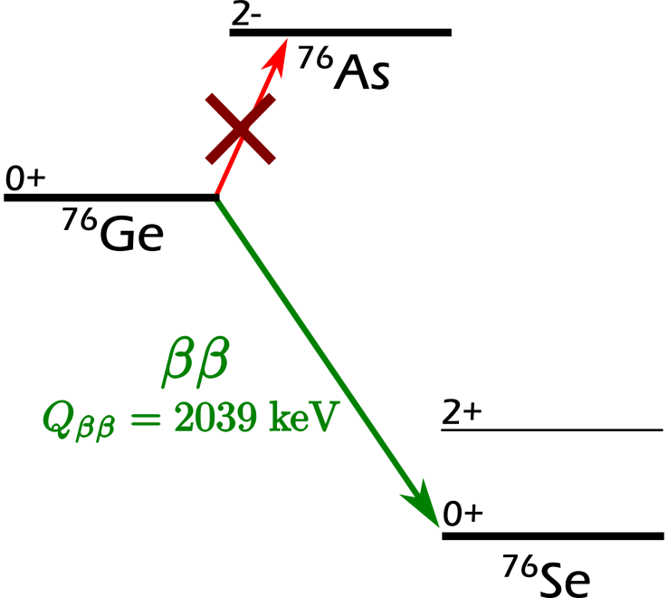
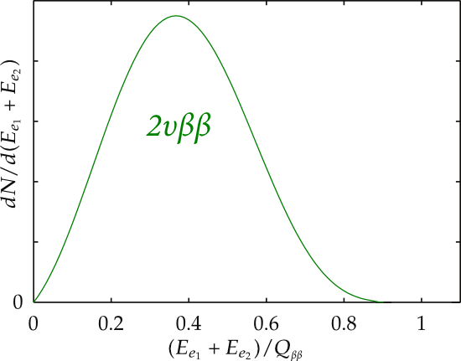
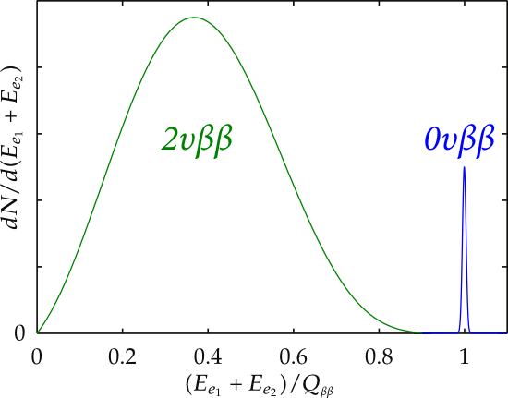
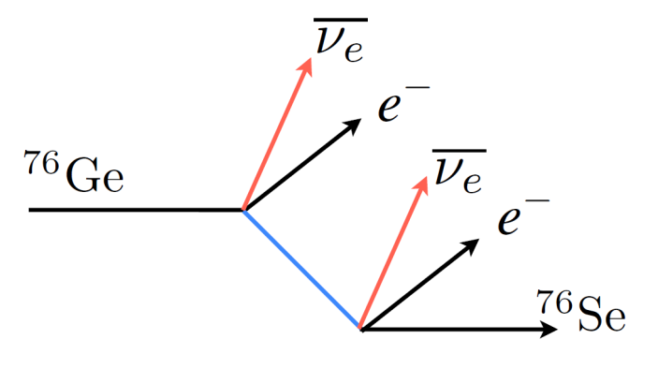
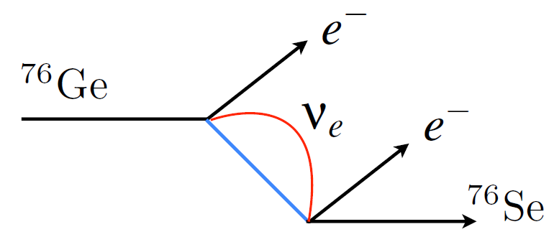
Neutrinoless double beta decay (0νββ)
$$2νββ:$$
$$76Ge →76Se+2e^{−}+2\overline{ν_{e}}$$
$$0νββ:$$
$$76Ge →76Se+2e^{−}$$
$ΔL=0$, $T_{1/2} \sim 10^{18}−10^{24} yr$
$ΔL=2, T_{1/2}>8.0 ×10^{25} yr$(⁷⁶Ge)

Slide 4
Neutrinoless double beta decay (0νββ)
If 0νββ observed:
violates the Lepton Number by 2 units = New Physics!
determines the nature of neutrinos: Majorana particle ($ν=\overline{ν}$)
gives information on the ν mass via m_{ββ} (light neutrino exchange scenario)
has never been observed so far!

Slide 5
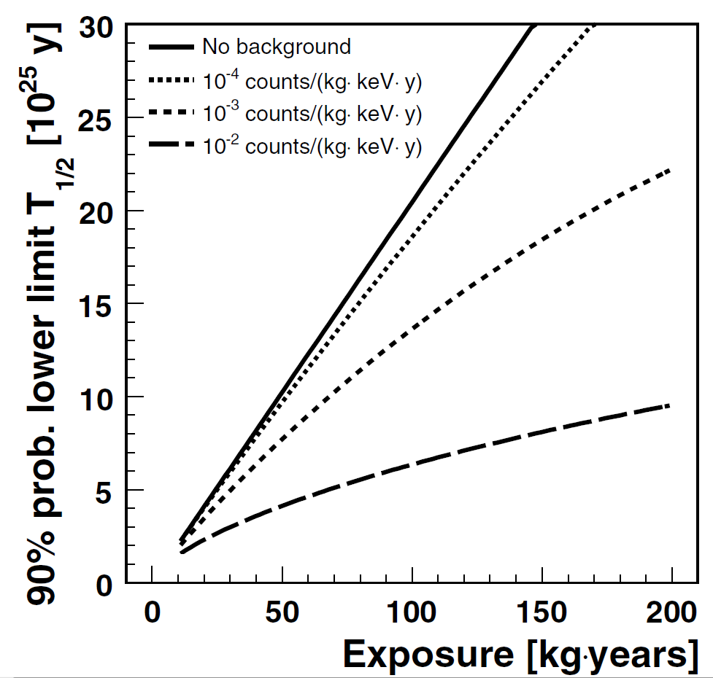
Sensitivity of the $0νββ$ experiment
Half-life limit calculation:
No background:
$T_{1/2}\left(90\% CL\right)>\frac{ln2}{1.64}\frac{N_{A}}{A}ε∙a∙M∙T$
With background:
$T_{1/2}\left(90\% CL\right)>\frac{ln2}{1.64}\frac{N_{A}}{A}ε∙a\sqrt{\frac{M∙T}{B∙∆E} }$
High background level (B) causes a saturation of the sensitivity curve!
Lowering background is the key in this kind of experiments!
Exposure = isotope mass × meas. time

Slide 6
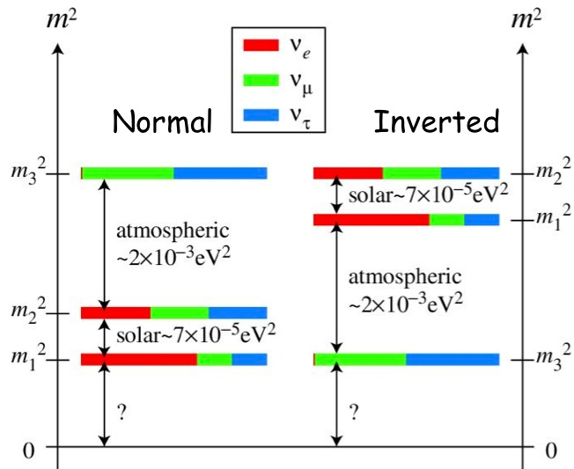
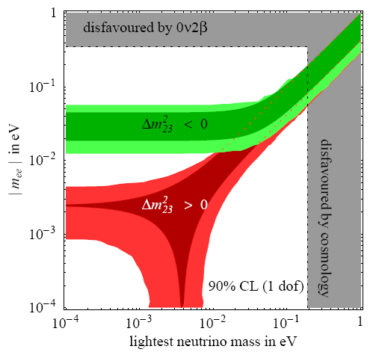
Neutrino mass – inverted or normal hierarchy?
claim of evidence
10²⁵ yr (GD I)
10²⁶ yr (GD II)
10²⁷ yr (LEGEND 200)
10²⁸ yr (LEGEND 1T)
Determining the limit on effective neutrino mass can reject inverted hierarchy hipothesis
Effective neutrino mass calculation:
$\frac{1}{T_{1/2}}=G\left(Q,Z\right) ∙ {|Mnuc|}^{2}$ $∙ {<m_{ee}>}^{2}$
$<m_{ee}>$ - effective neutrino mass
$G\left(Q,Z\right)$ - space phase factor
$Mnuc$ – nuclear matrix element

Slide 7
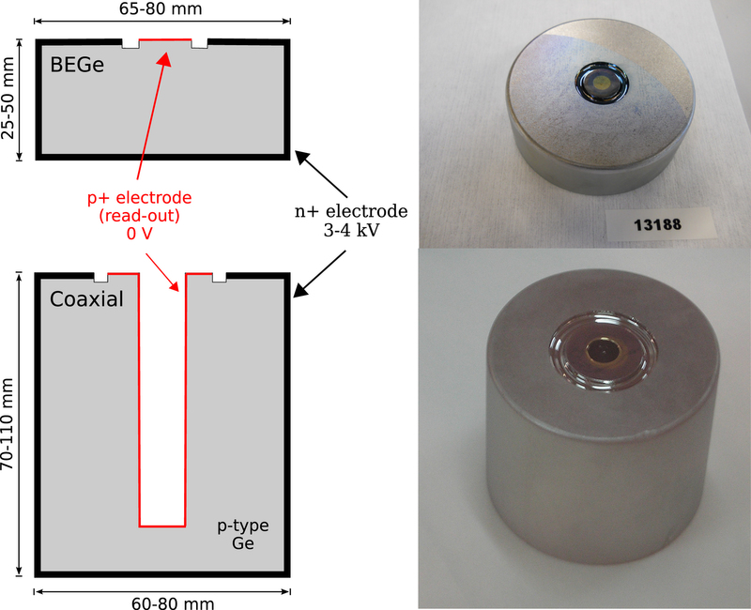
GERDA experiment
GERDA (GERmanium Detector Array) has been designed to investigate neutrinoless double beta decay of ⁷⁶Ge ($Q_{ββ}=2039 keV$)
Ge mono-crystals are very radiopure
Ge detectors have excellent energy resolution
High detection efficiency (detector = source, $ε≈1$)
Enrichment of ⁷⁶Ge required (7.4% → 86%)
Source: GERDA collaboration

Slide 8
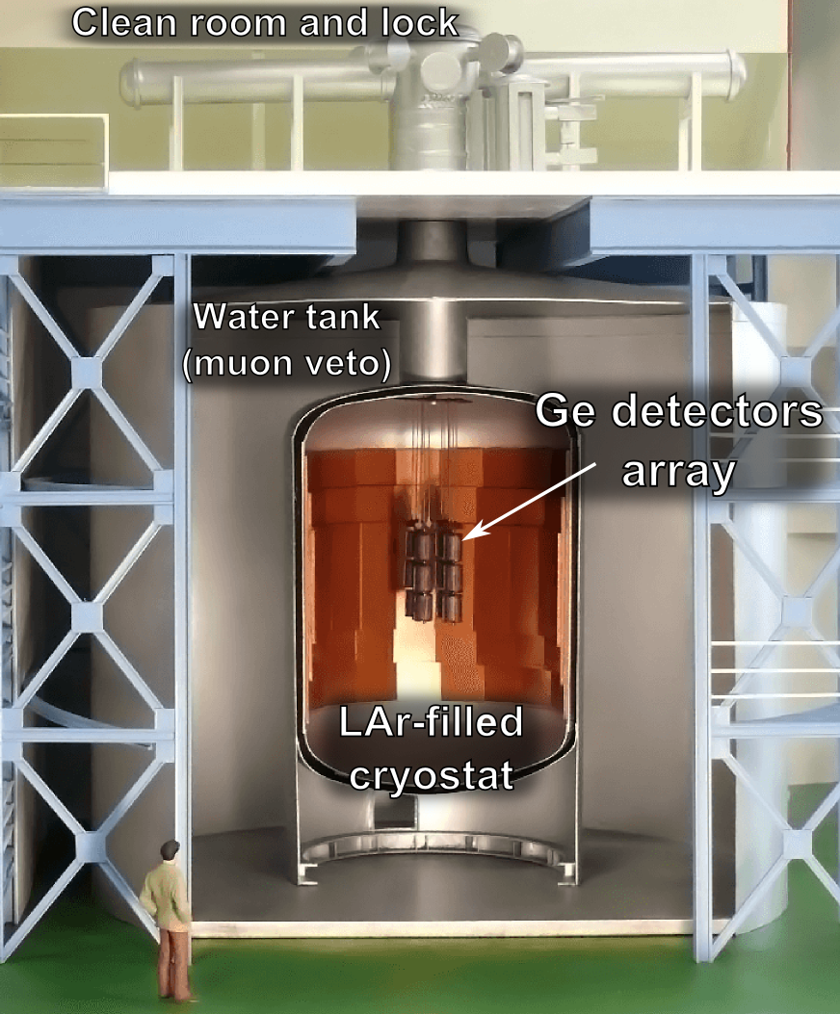
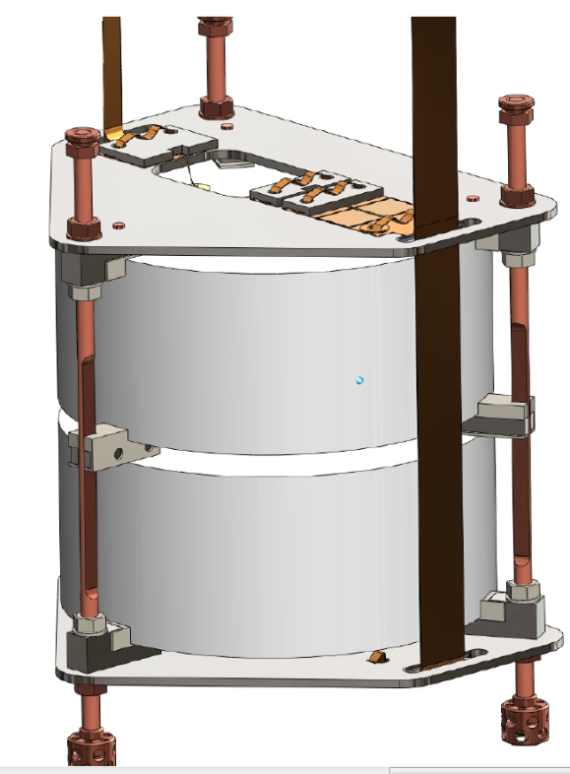
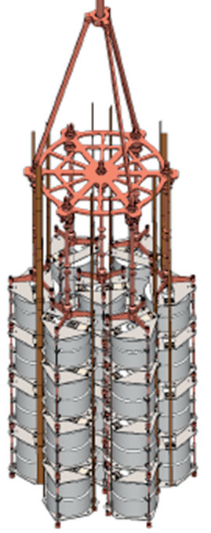
Design of GERDA
Main design features:
bare HPGe diodes immersed in LAr (cooling)
Readout of LAr scintillation light via PMTs and SiPM (active veto)
Readout of germanium signals
≈ 30 mm
≈ Ø4 m
≈ Ø80 mm
Source: GERDA Collaboration

Slide 9
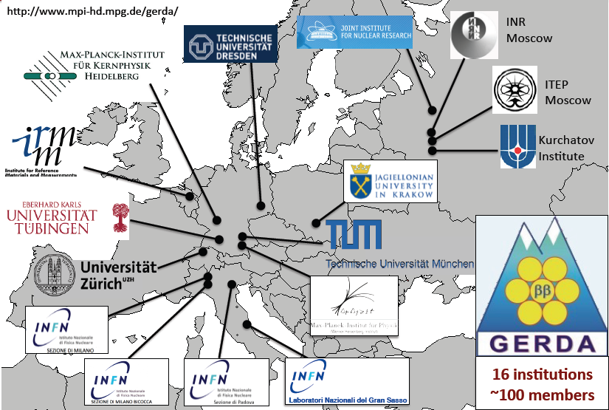
GERDA: the collaboration

Slide 10
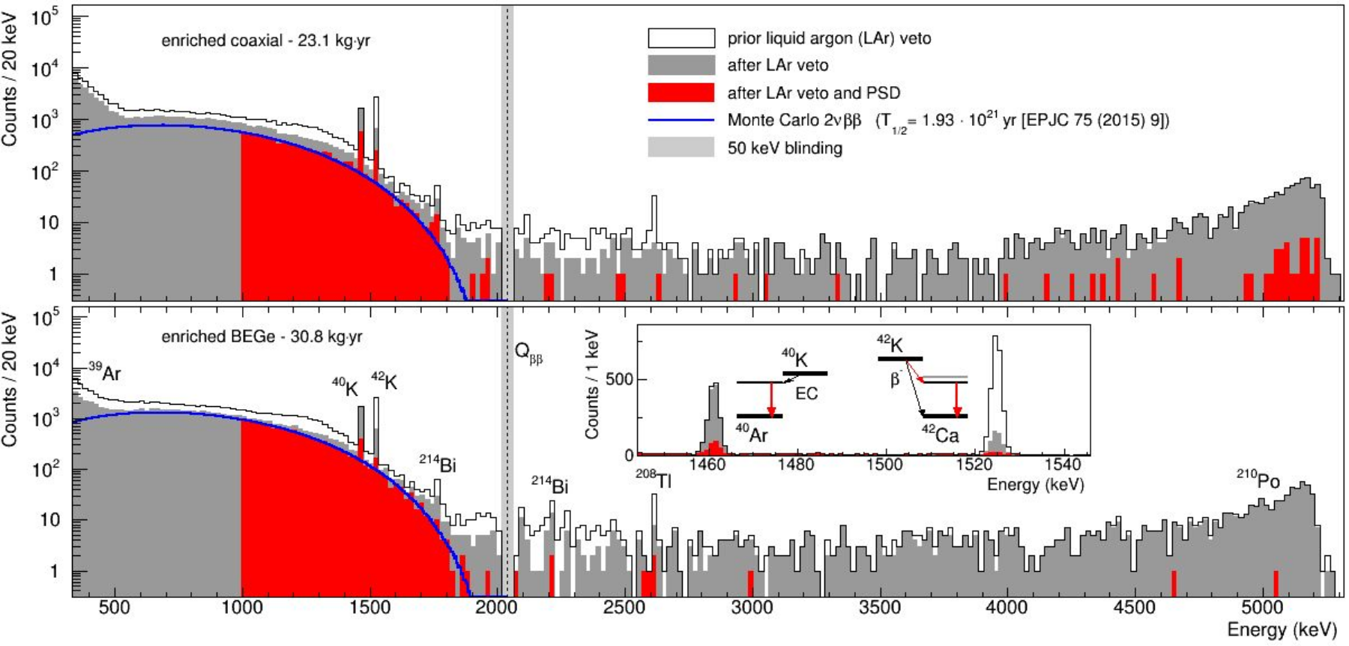
GERDA Phase II results
10.5281/zenodo.1287604
Neutrino (2018)
Y. KERMAÏDIC @ La Thuile 2019
Energy spectrum of GERDA Phase II (58.9 kg∙yr of exposure)
[600-1300] keV - 2𝜈𝛽𝛽 decays produce single-site events -> No suppression
[1450-1530] keV - Strong suppression of ⁴⁰K and ⁴²K gamma lines (MSE)
[> 3000] keV - Suppression of almost all 𝛼 events (p⁺ contact)

Slide 11
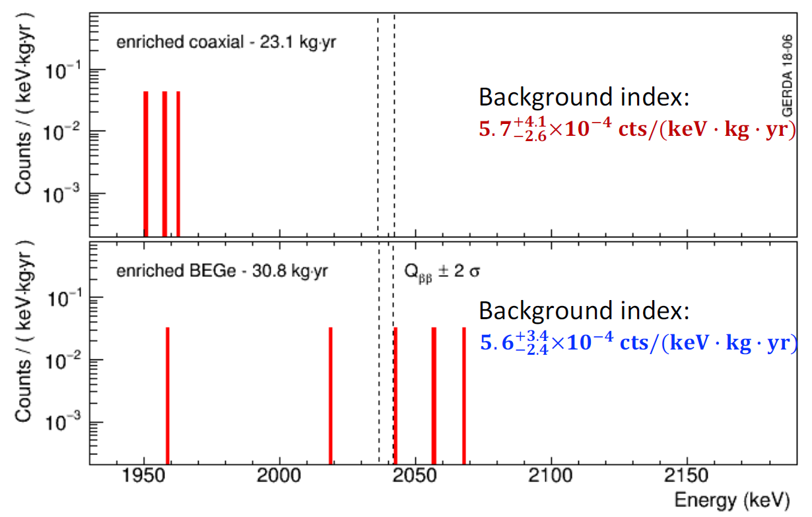
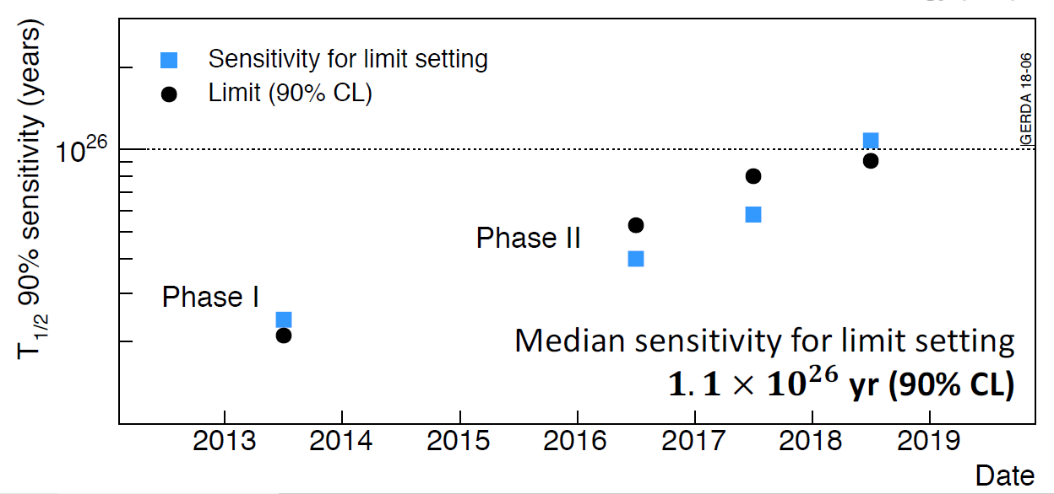
GERDA Phase II results
Achieved extremely low background index (for both semi-coaxial and BEGe datasets)
best in the field when normalized to FWHM (ca. 3.0-3.5 keV)
Median sensitivity for limit setting 1.1∙10²⁶ yr (90% CL):
Best fit → no signal
T_{1/2} > 0.9∙10²⁶ yr (90% CL)
GERDA is operating in background-free regime (linear increase of $T_{1/2}$ sensitivity)
100 kg⋅yr of exposure is planned to be reached by the end of 2019
1.3⋅10²⁶ yr (for the limit) or ∼ 8⋅10²⁵ yr (50% for 3σ discovery)
10.5281/zenodo.1287604 Neutrino (2018), Y. KERMAÏDIC @ La Thuile 2019

Slide 12
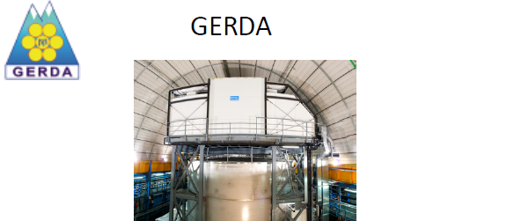
LEGEND: beyond GERDA Phase II
GD + MJD + new groups = LEGeND (Large Enriched Germanium Experiment
for Neutrinoless Double Beta Decay)
Physics goals: investigation of degenerate neutrino mass range
Technology: study of background reduction techniques
First phase: LEGEND 200 → exposure of 1 t⋅yr
Final phase: LEGEND 1T → exposure of 10 t⋅yr

Slide 13
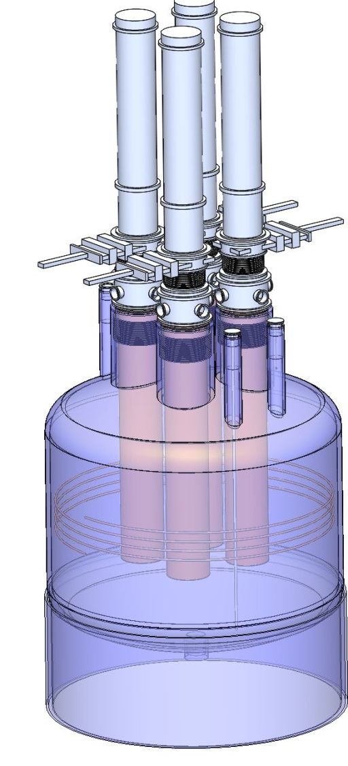
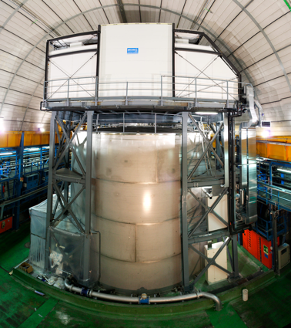
LEGEND design
First phase:
(up to) 200 kg
Adaptation of existing GERDA infrastructure at LNGS
Background goal (3-5x lower)
Next stages:
1000 kg (staged)
Background reduction: factor 30 w.r.t GERDA
Location: TBD
LEGEND 1000:
Baseline design of the cryostat
GERDA cryostat
Notes:
Relatywnie szybki upgrade infrastruktury gerdy
Detektory z majorany
Kriostat gerdy

Slide 14
LEGEND - schedule
2018
2019
2020
2021
2022
2023
GERDA (100 kg yr)
Majorana (75 kg yr)
LEGEND-200 Purchase Isotope
Fabricate Detectors
Develop/Install New Lock, Experimental Apparatus
Integration/Commissioning
LEGEND-200 Data Runs, Goal: 1 t yr (~5-7 years)
Ton-Scale Down-Select Process
LEGEND-1000 Design/Build, ~6yrs, 2021-2027
Earliest LEGEND-1000 Data Start 2025/6

Slide 15
GERDA: Polish contribution and acknowledgments
IF UJ: member of the GERDA collaboration since its formation
Contribution to low background techniques, electronics and data analysis:
Removal of radon daughters from metals
Investigation of radon daughters in cryogenic liquids
LArGe – liquid argon veto test facility
Pulse Shape Discrimination in semicoaxial detectors using Projective Likelihood method
PMT scaler used for LAr veto in Phase II
research on HPGe detectors technology
Cracow’s group involvement in GERDA supported by National Science Centre and Foundation for Polish Science grants (UMO-2012/05/E/ST2/02333, UMO-2016/21/B/ST2/01094, TEAM/2016-2/2017)
The most important papers:
The GERDA experiment for the search of 0νββ decay in ⁷⁶Ge, The European Physical Journal C, 2013
Results on Neutrinoless Double-β Decay of ⁷⁶Ge from Phase I of the GERDA Experiment, Phys. Rev. Lett. 111, 2013
Background-free search for neutrinoless double-β decay of ⁷⁶Ge with GERDA, Nature, 2017

Slide 16
Summary
GERDA– searching for 0νββ in ⁷⁶Ge (best en. resolution, high radiopurity)
Lowest background level achieved in the field of 0νββ experiments ($≈5.7∙{10}^{−4} cts/(keV∙kg∙yr)$)
Operating in the background-free regime ( < 1 cts in the Q_{ββ} energy window for the target exposure of 100 kg⋅yr )
The decay is not yet observed, the limit on the half-life: T_{1/2} > 0.9∙10²⁶ yr (90% CL)
LEGEND – worldwide collaboration, aiming at 10 t⋅yr → T_{1/2} > 10²⁸ yr → m_{ββ} ≈17 meV
Possibility to exclude inverted-hierarchy hypothesis, but also large discovery potential!

Slide 17
Thank you for attention!

Slide 18
Backup slides

Slide 19
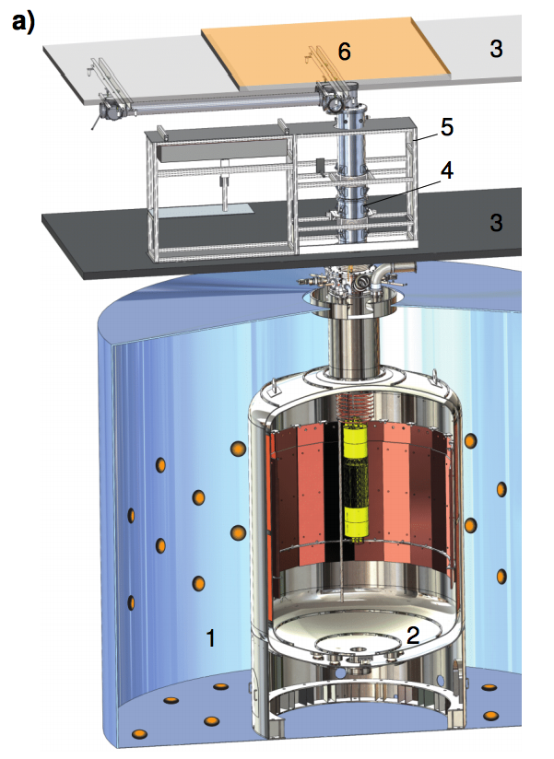
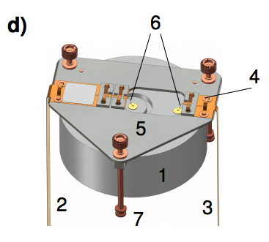
GERDA in more detail
plastic scintillator panels
muon veto
low-mass, low-activity electronics
low acitivity PMTs
lock system
clean room
wavelength shifting fibers with SiPM read-out
Ge detector array
low acitivity PMTs
low mass detector holder
64 m³ LAr cryostat
coolant, shielding
590 m³ ultra-pure water
neutron moderator/absorber
muon Cherenkov veto
BEGe detector

Slide 20
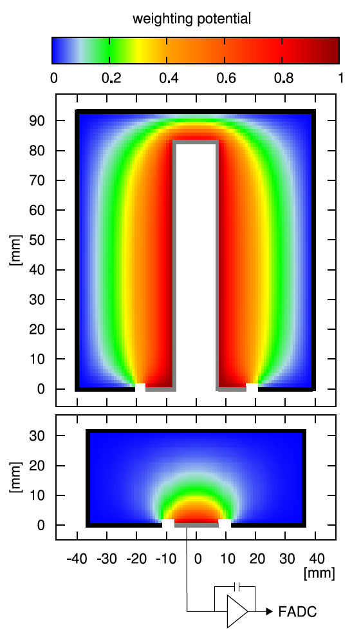
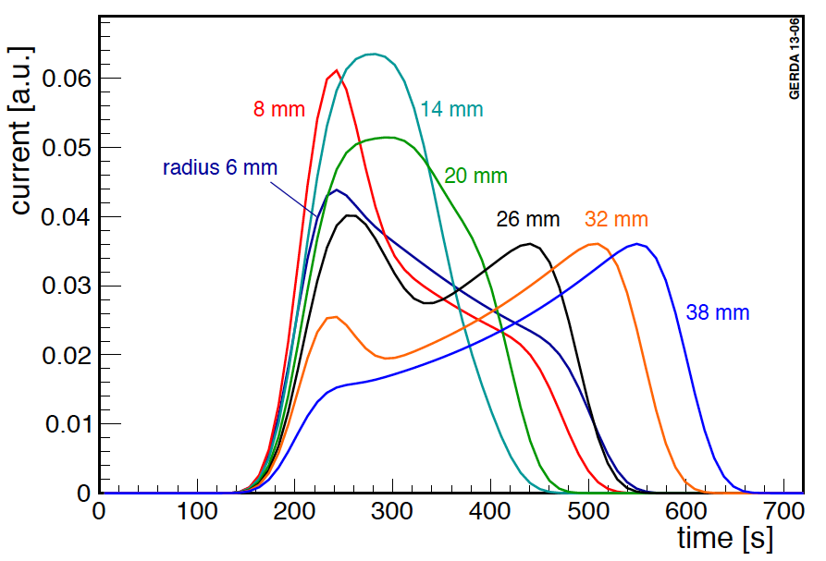
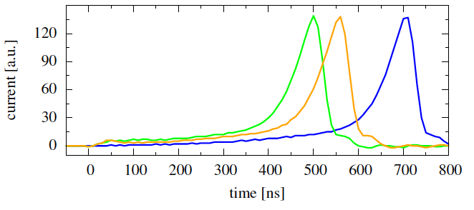
Pulse Shape Analysis
Simulated current pulses in a semi-coaxial detector
Different signal structure than in BEGes (due to E-field) – A/E does not work!
Simulated current pulses in a BEGe detector
arXiv:1307.2610, arXiv:1012.4300

Slide 21
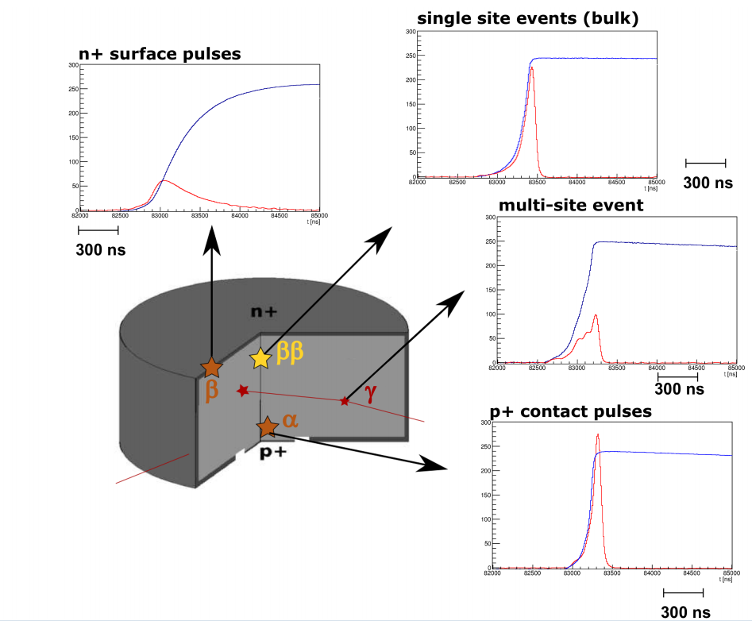
Pulse Shape Analysis
Single site events – single energy deposition in the detector ($0νββ$, single Compton scattering)
Multi site events – multiple energy deposition in detector (gamma Full Energy Peaks, Single Escape Peak)
Surface events (n⁺ and p⁺ contacts) – α and β particles
Source: A. Lazzaro talk at DPG Spring meeting, "Hadronen und Kerne" HK, 23.-27.3. 2015

Slide 22
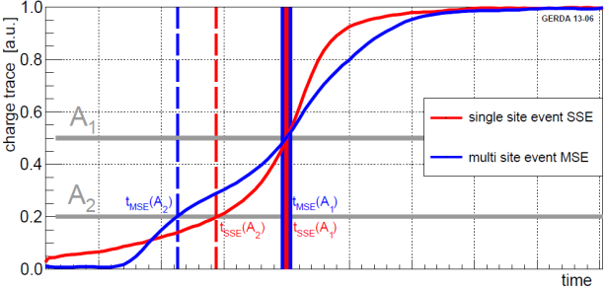
Pulse Shape Analysis
PSD for coax detectors less effective than for BEGes
Artificial neural network (ANN), as in Phase I
Trained on signal (SSE) : ²⁰⁸Tl (2614 keV) DEP at 1592 keV
Background (MSE): ²¹²Bi @ 1620 keV FEP γ-line
Acceptance for 0νββ events: (85±5)%
Double check with Compton edge and 2ν2β
MC simulation of waveforms
Eur. Phys. J. C 73 (2013) 2583
Nature 544 (2017) 47

Slide 23
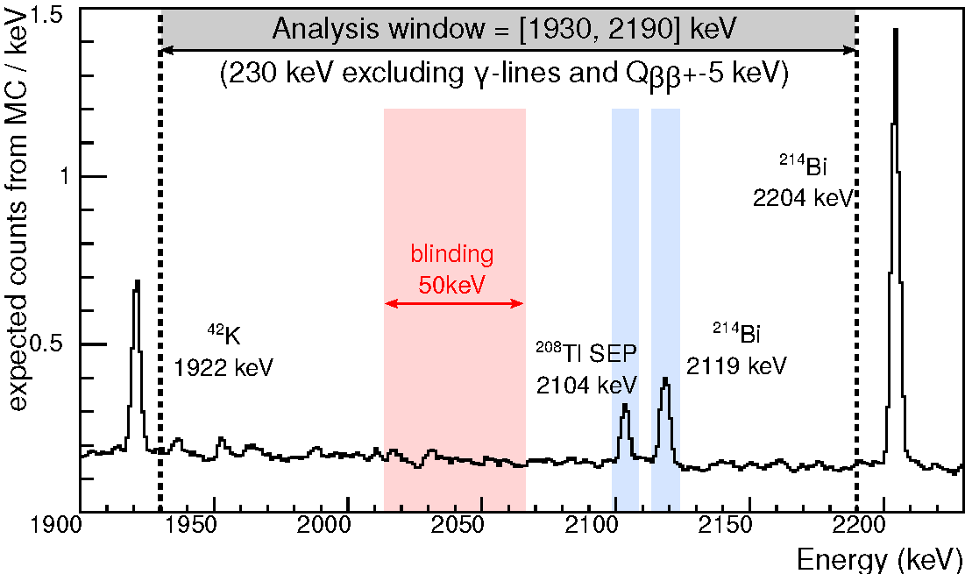
Analysis range

