Slide 1









RADIOPHARMA INNOVATION DAY
DRIVE YOUR WORKFLOW
//
CUSTOMIZE YOUR BUSINESS
Presented by:
NCBJ
Date:
15 October 2026
We acknowledge support form the European Union’s Horizon 2020 research and innovation program under the NOMATEN Teaming grant agreement No. 857470 and from the Ministry of Science and Higer Education’s initiative “Support for the Activities of Centers of Excellece Established in Poland under the Horizon 2020 Program” under agreement No. MEiN/2023/DIR/3795

Slide 2
1
2
Project Design
Project Overview
And The Goals.
A website designed specifically for a corporate entity aiming to drive business growth and maintain strong connections with its customers.
Competitive Analyst
Introduction
The goal of this website is to enhance the company’s digital presence, deliver information efficiently to clients, and streamline access to services and communication channels.

Slide 3
Term Flow Depicts Movement
Project Workflow.

Slide 4
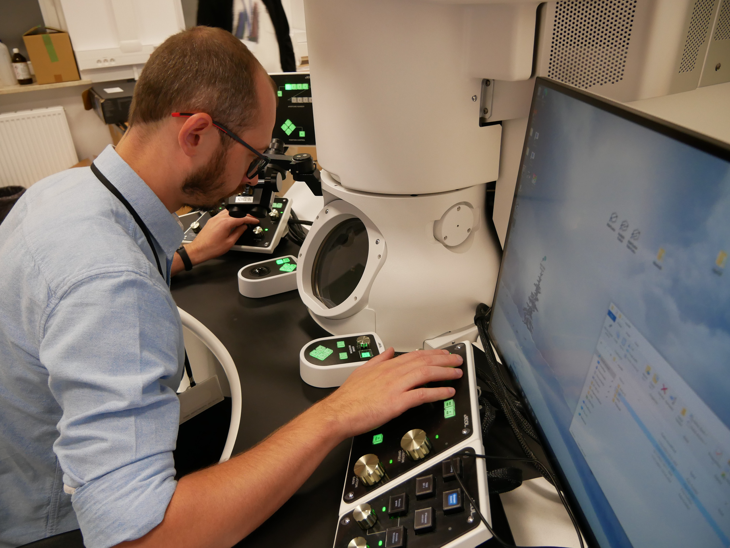

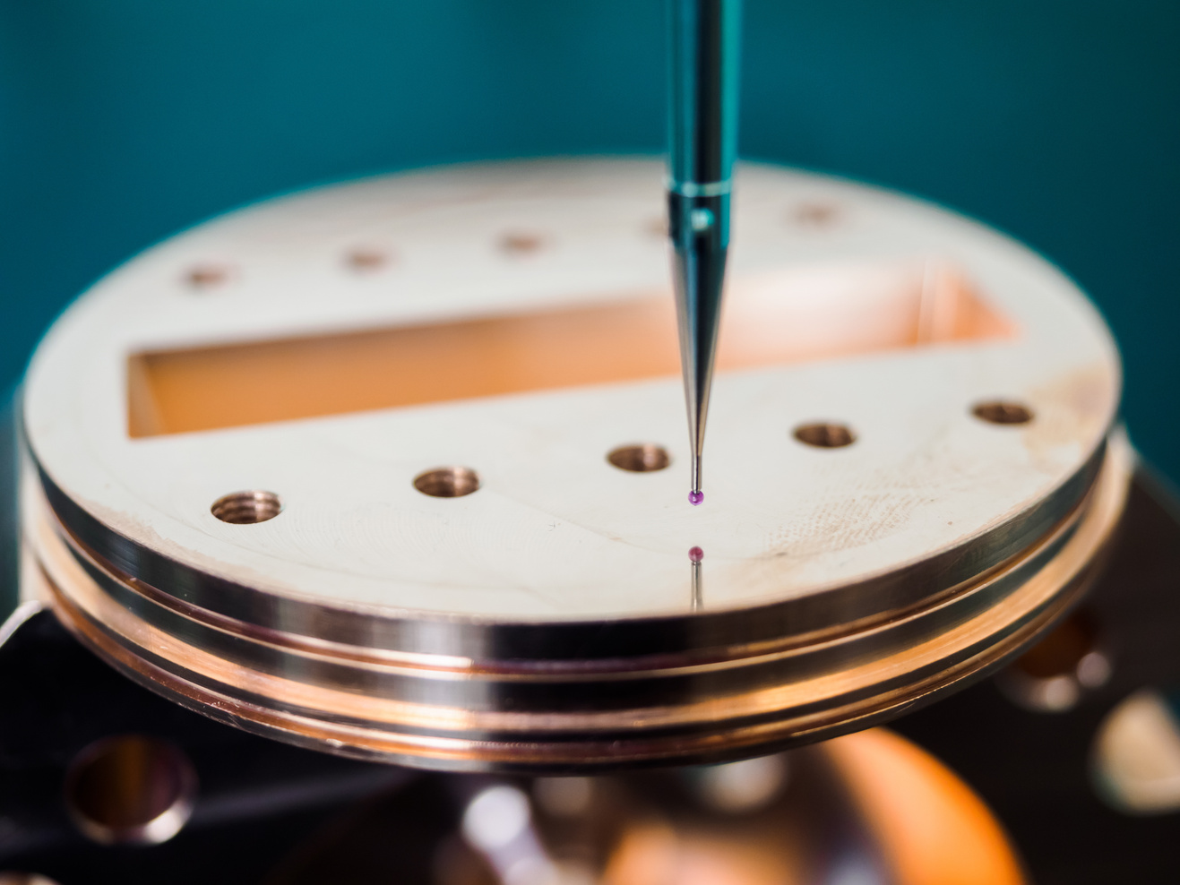

Highlights of Our Work
Our Portfolio.
We take pride in the diverse range of projects we’ve delivered across various industries. Each project reflects our commitment to quality, user experience, and results-driven design.
Do things at your own pace. Life's not a race.

Slide 5
Presentation 2025
01
Experienced team with a strong design portfolio and consistent project delivery. We understand client needs and turn them into impactful results.
Limited marketing presence and a small team, which can affect our capacity to handle large projects simultaneously.
Rising demand for digital services and potential to expand into new markets and partnerships.
High competition, fast-changing trends, and evolving client expectations require constant adaptation.

Slide 6
Phase 01
Phase 02
Discovery & Workshops
Production & Review
Professional Workflow
Project Timeline.

Slide 7
THANK YOU
PhD Jan Kowalski
email: jan.kowalski@ncbj.gov.pl
We acknowledge support form the European Union’s Horizon 2020 research and innovation program under the NOMATEN Teaming grant agreement No. 857470 and from the Ministry of Science and Higer Education’s initiative “Support for the Activities of Centers of Excellece Established in Poland under the Horizon 2020 Program” under agreement No. MEiN/2023/DIR/3795

Slide 8
RADIOPHARMA INNOVATION DAY
15 October 2026
Jan Kowalski
National Centre
for Nuclear Research
We acknowledge support form the European Union’s Horizon 2020 research and innovation program under the NOMATEN Teaming grant agreement No. 857470 and from the Ministry of Science and Higer Education’s initiative “Support for the Activities of Centers of Excellece Established in Poland under the Horizon 2020 Program” under agreement No. MEiN/2023/DIR/3795

