Slide 1
Search for Exotics in B decays at LHCb
Graduate Physics Seminar
Salil Joshi
Supervisor : Prof. Wojciech Wislicki
Auxiliary Supervisor: Dr. Dmytro Melnychuk

Slide 2
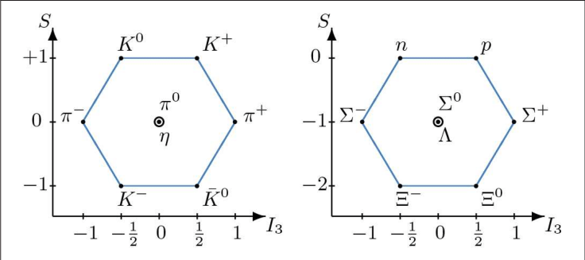
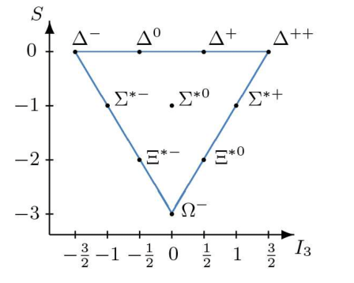
A brief history of Hadron spectrum
Gell-Mann and Zweig (1964): hadrons described as composites of fractionally charged fermions, Quarks with baryon number B = ⅓.
Original Quark Model : u,d and s quarks and Baryons (qqq, B = 1) & Mesons ( qq, B = 0).
Quantum Chromodynamics : Generalization to a gauge theory with quarks of fractional electric charge. (1973)
J = 3/2 Ω⁻ baryon as (sss) ➪ Pauli Exclusion principle Violated!
Solution : Hidden quantum number
1965, Han and Nambu propose : each of the quarks are SU (3) triplets in flavor-space and with strong-interaction “charges” that are a triplet in another SU (3) space.
3 color charges (r-b-g) & 3 anti color charges (y-m-c).
Baryon and Meson : color neutral

Slide 3
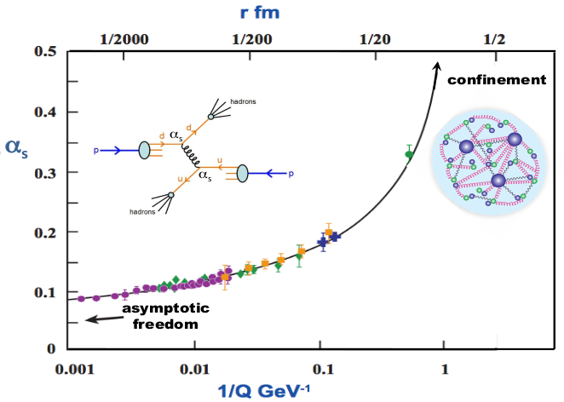
A brief history of Hadron spectrum
Color force is mediated by eight massless vector particles called Gluons.
Gluons have color charges ⇒ interact with each other.
The vacuum polarization diagram, modify the coupling strength (⍺_{s} ) : decreases at short distances and increases at long distances.
Consequences :
Asymptotic Freedom : small coupling strength at short distances
Use Perturbation theory for high-momentum (P_{T}) transfer processes.
Distance scales : r ∼ 1 fm (characteristic of the sizes of hadrons), ⍺_{s} ∼ O(1) and perturbation expansions do not converge.
Confinement : increase in the coupling strength ⇒ only color-charge-neutral isolated hadrons can exist.
r : quark separation
1/Q : inverse-mom transfer
⍺_{s} : coupling strength

Slide 4
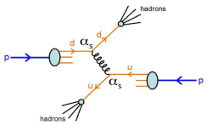
A brief history of Hadron spectrum
Confinement : no free quark-gluons in experiments.
α_{s} ∼ 1 ⇒ q-g tightly bound inside hadrons.
P_{T} distribution of quarks inside hadron governed by long-distance QCD.
Quark-quark elastic scattering : description based on perturbative QCD.
Experiments : two high transverse momentum jets of hadrons.
No rigorous description of these hadrons and their spectrum, as bound-quark systems from the QCD Lagrangian.
QCD Dilemma : Nearly total disconnect between the hadrons that we observe in experiments and the quarks and gluons that appear in the theory.
Effective theories/models approximate QCD by simplifying the complexity but may not capture "ALL" detailed properties of hadrons.
Experiments can identify patterns in hadron physics - study hadrons with substructures more complex than the baryons & mesons of the original quark model :
Powerful insights : Masses, decay channels, widths and lifetimes
Testing the Boundaries of the Quark Model : richer hadron spectrum than predicted!
Probing Confinement and Color Dynamics
Insights into Hadronization Mechanisms

Slide 5
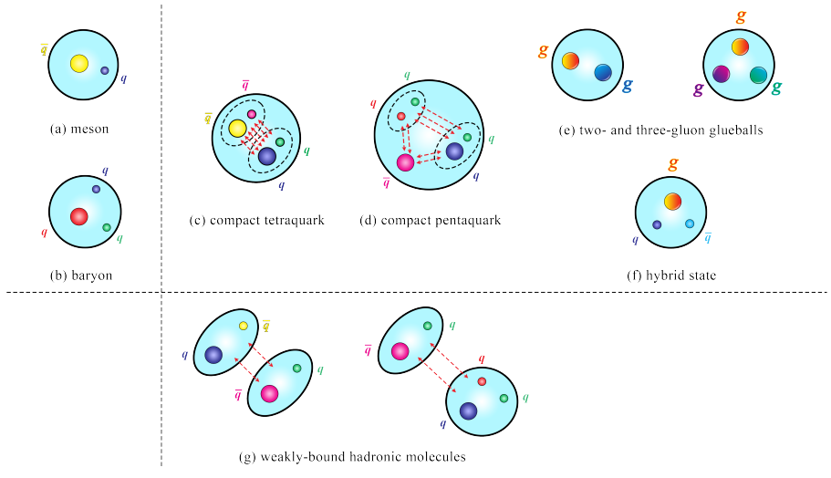
Exotics
Conventional States : states well understood phenomenologically in the Quark Model i.e. qq̅ and qqq
Exotic states : 4-5 quark states, unconventional quantum numbers ,….

Slide 6
Exotic Hadrons : Models
Simplified models motivated by the color structure & general features of QCD
QCD-color-motivated models
QCD diquarks : formed from tightly bound colored diquarks
QCD hybrids : color singlet combinations of quarks and one or more “valence” gluons;
Glueball mesons : comprised only of gluons
Other models
Hadronic molecules : mesons and baryon forming molecule-like systems that are bound via Yukawa-like nuclear forces
Hadrocharmonium : comprised of quarkonium cores surrounded by clouds of light quarks and gluons

Slide 7
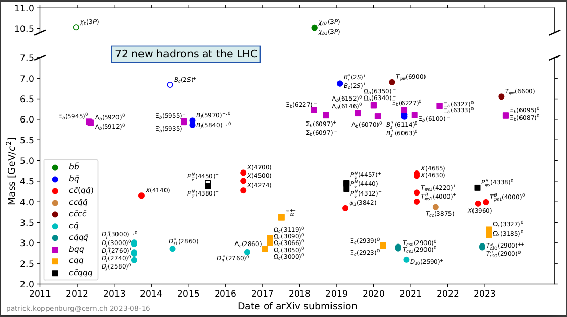
Hadron Spectroscopy at LHC

Slide 8
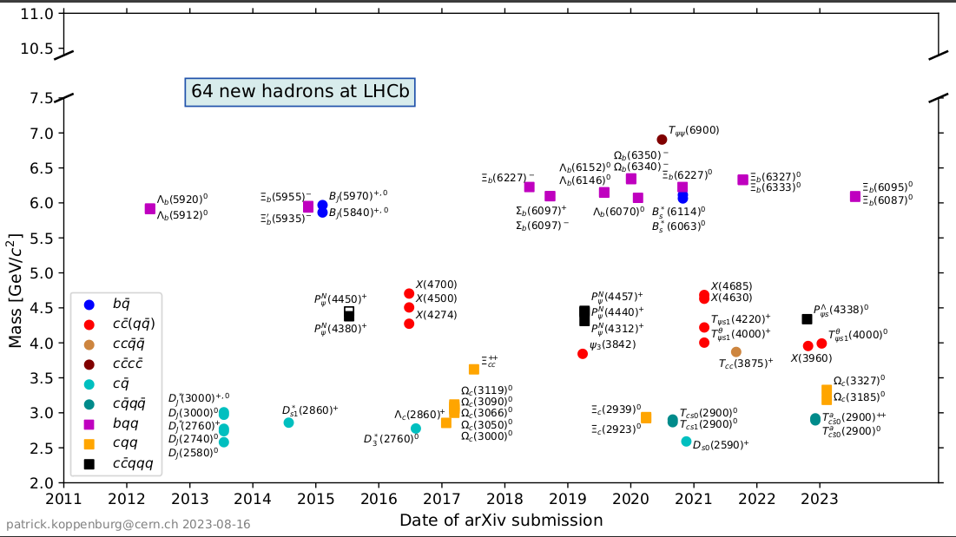
Hadron Spectroscopy at LHCb

Slide 9
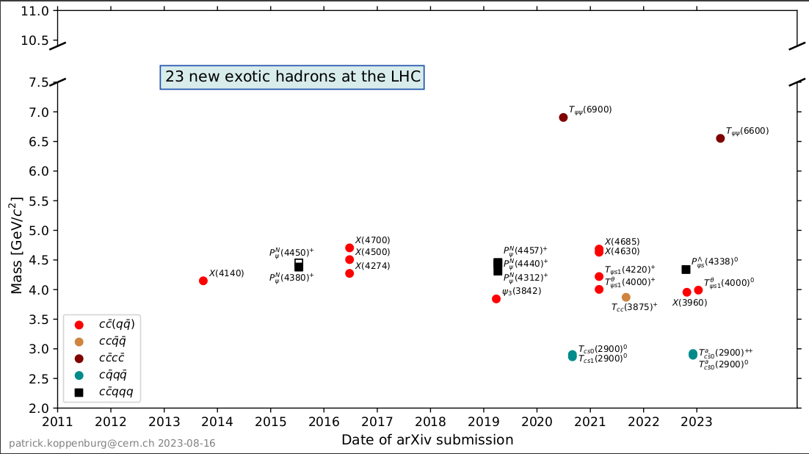
Exotic Hadrons at LHC

Slide 10
B decays
bb̅ pair produced in high-energy collisions, hadronizes separately.
B meson are a b̅ and u,d,s, or c quark : B⁺, B⁰, B_{c}, and B_{s}
Decay via generation-changing processes : b →cW⁻
Forms charmed mesons or cc̄ (charmonium).
My PhD work is dedicated to search for exotics in charmonimum (cc̄) sector at LHCb.
Why Charmonium?
Charm : lightest ‘heavy’ quark (m_{c} >> Λ_{QCD} ) can determine cc̄ spectrum with simple non-relativistic Q-M treatment.
Decays of conventional cc̄ states are OZI suppressed - states are narrow and well separated.
Above the open charm (m_{DD̄} ) threshold OZI allowed : wider resonances but still significantly narrower than light quark states.
Have reliable predictions of expected conventional states.

Slide 11
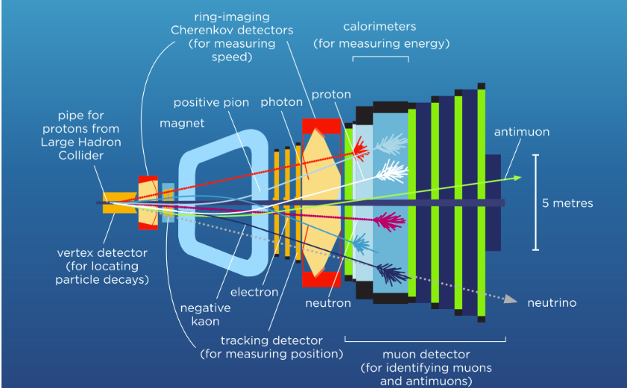
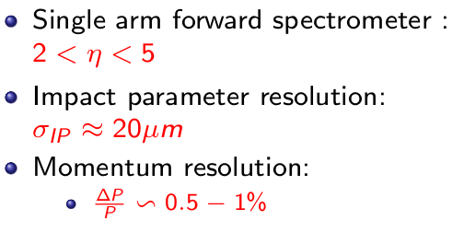
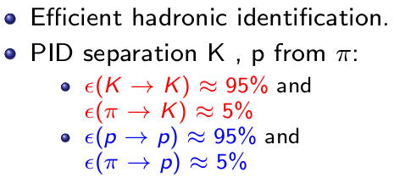
Why LHCb?
Largest data sample of b and c hadrons
Triggers optimised for final state particles J/Ψ(1S) and Ψ(2S).
Dedicated computational tools available for thorough search of exotics.

Slide 12
B0 -> ?
(B⁰→ J/ψ(1S) π⁺ π⁰ K⁺)
Reconstruct the decay from real data
Reconstruct the decay from Monte Carlo data
Extract clean B⁰ signal, fit the mass distribution, extract model parameters
Apply selection cuts : appropriate windows on kinematic variables and vetoes, look at invariant mass of B0 (Cut optimization is the most time consuming step and requires experience)
Multivariate Analysis : 1. Clean Signal from MC
2. Background sidebands from Data
Prepare a machine learning based training using discriminating variables for separation of signal from background : BDT
No observable peaking structure 🥲
Observe a peak around B0 mass 😃
Finding the optimum working point : Signal Significance Vs BDT Cut (After all vetoes)
Repeat the whole process for the reference channel
Multiplicity Correction
1. Make a simple model for signal (Gaussian) and background (expo.) 2. Perform a fit , extract weights from signal events
3. Fit the intermediate particle mass combinations
Fit Model : Signal as DSCB and Background as Chebyshev Polynomial
Make final fit of B0 invariant mass in data and MC
Extract yields & weights : Branching fraction & search of Exotics
NO interesting structures.
(You can always measure the branching fraction)
You see some interesting structures.
Caution : It’s too soon to be happy
Calculate Branching fraction wrt a Reference channel
Fit mass of intermediate states and hope that the “interesting” structures survived 😃😃😃
Estimate uncertainties : most importantly systematics

Slide 13
We have observed 3 new decay modes of B⁰ meson
B⁰ → (J/ψ π⁺ π⁻π⁰ )π⁺K⁻
Search for ψ(4230)→ J/ψ π⁺ π⁻ π⁰
Measure Branching fraction
B⁰ →J/ψωπ⁺K⁻
Search for X(3940)→ J/ψω
Measure Branching fraction
B⁰ →(ψ(2S)π⁰)π⁻K⁺
Measure Branching fraction

Slide 14
B0 -> ?
(B⁰ → J/ψ(1S) π⁺ π⁻ K⁺)
Reconstruct the decay from real data
Reconstruct the decay from Monte Carlo data
Extract clean B⁰ signal, fit the mass distribution, extract model parameters
Apply selection cuts : appropriate windows on kinematic variables and vetoes, look at invariant mass of B0 (Cut optimization is the most time consuming step and requires experience)
Multivariate Analysis : 1. Clean Signal from MC
2. Background sidebands from Data
Prepare a machine learning based training using discriminating variables for separation of signal from background : BDT
No observable peaking structure 🥲
Observe a peak around B0 mass 😃
Finding the optimum working point : Signal Significance Vs BDT Cut (After all vetoes)
Multiplicity Correction
1. Make a simple model for signal (Gaussian) and background (expo.) 2. Perform a fit , extract weights from signal events
3. Fit the intermediate particle mass combinations
Fit Model : Signal as DSCB and Background as Chebyshev Polynomial
Make final fit of B0 invariant mass in data and MC
Extract yields & weights : Branching fraction & search of Exotics
NO interesting structures.
(You can always measure the branching fraction)
You see some interesting structures.
Caution : It’s too soon to be happy
Calculate Branching fraction wrt a Reference channel
Fit mass of intermediate states and hope that the “interesting” structures survived 😃😃😃
Estimate uncertainties : most importantly systematics

Slide 15
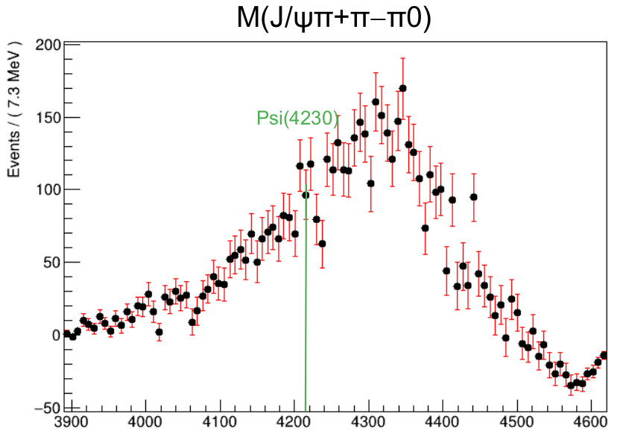
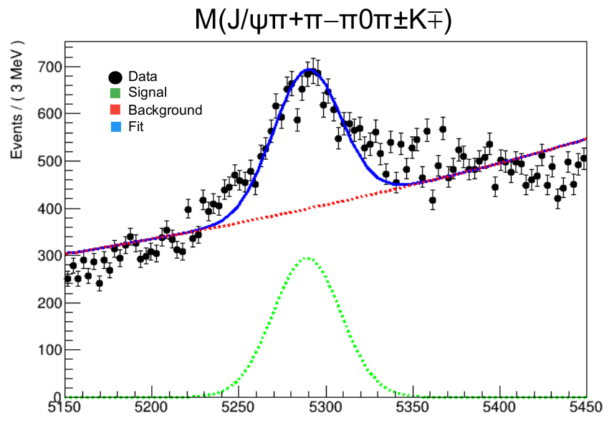
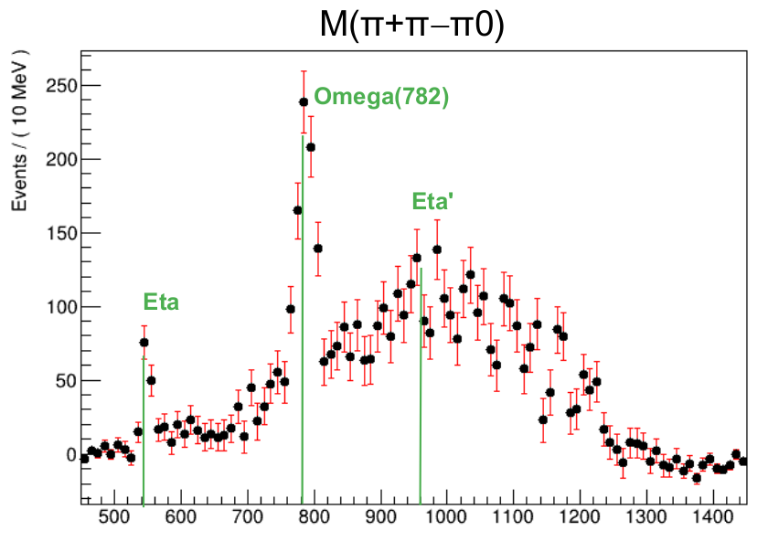
DATA : B⁰ → (J/ψπ⁺ π⁻ π⁰ )π⁺ K⁻

Slide 16
B0 -> ?
(B⁰ → J/ψ(1S) π⁺ π⁻ K⁺)
Reconstruct the decay from real data
Reconstruct the decay from Monte Carlo data
Extract clean B⁰ signal, fit the mass distribution, extract model parameters
Apply selection cuts : appropriate windows on kinematic variables and vetoes, look at invariant mass of B0 (Cut optimization is the most time consuming step and requires experience)
Multivariate Analysis : 1. Clean Signal from MC
2. Background sidebands from Data
Prepare a machine learning based training using discriminating variables for separation of signal from background : BDT
No observable peaking structure 🥲
Observe a peak around B0 mass 😃
Finding the optimum working point : Signal Significance Vs BDT Cut (After all vetoes)
Multiplicity Correction
1. Make a simple model for signal (Gaussian) and background (expo.) 2. Perform a fit , extract weights from signal events
3. Fit the intermediate particle mass combinations
Fit Model : Signal as DSCB and Background as Chebyshev Polynomial
Make final fit of B0 invariant mass in data and MC
Extract yields & weights : Branching fraction & search of Exotics
NO interesting structures.
(You can always measure the branching fraction)
You see some interesting structures.
Caution : It’s too soon to be happy
Calculate Branching fraction wrt a Reference channel
Fit mass of intermediate states and hope that the “interesting” structures survived 😃😃😃
Estimate uncertainties : most importantly systematics

Slide 17
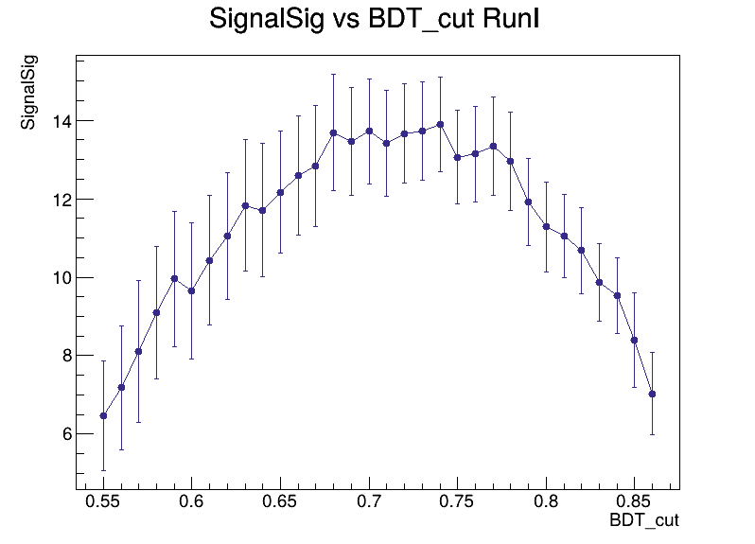
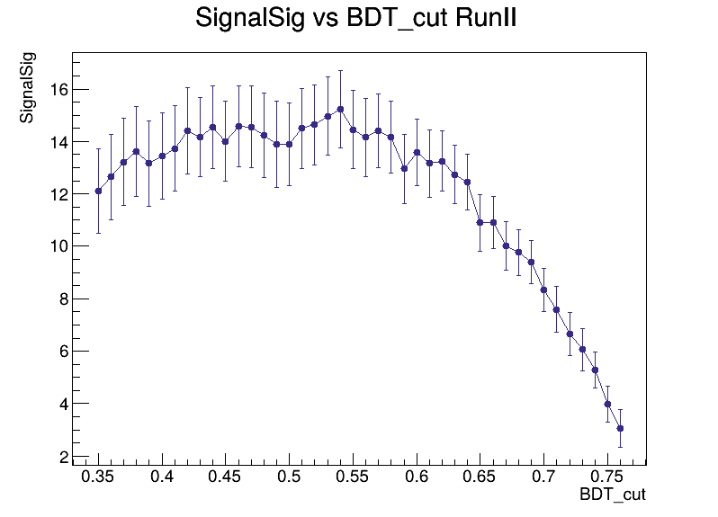
Figure of Merit or Signal Significance
FoM = S/√(S+B)
Apply a cut : BDT > x
Fit invariant mass of B meson :
Signal : DSCB
Background : exponential
Extract signal and background events and evaluate FoM at different x values.
Optimum working point : BDT value corresponding to maximum FoM.

Slide 18
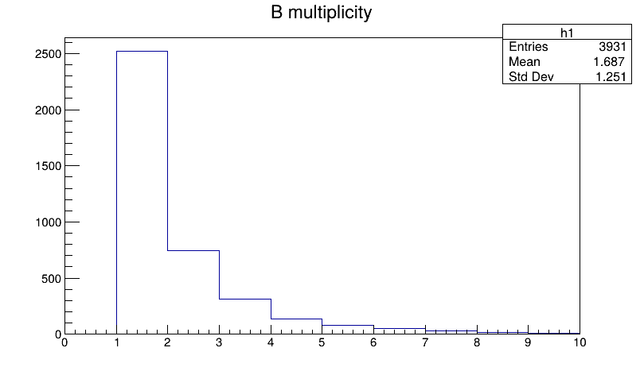
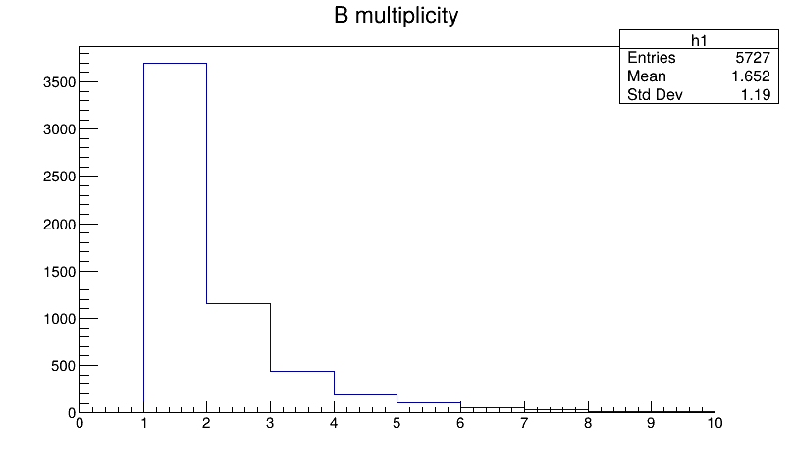
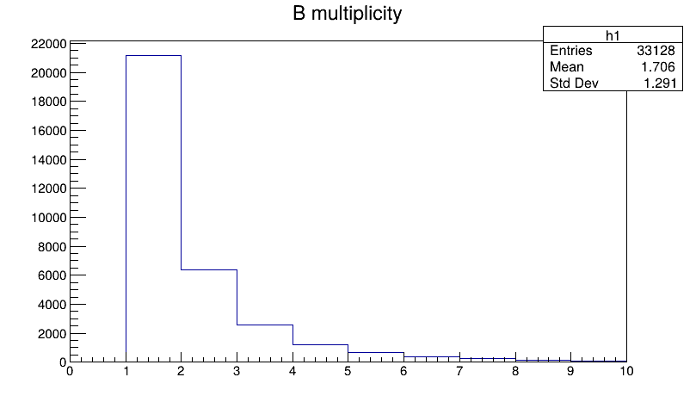
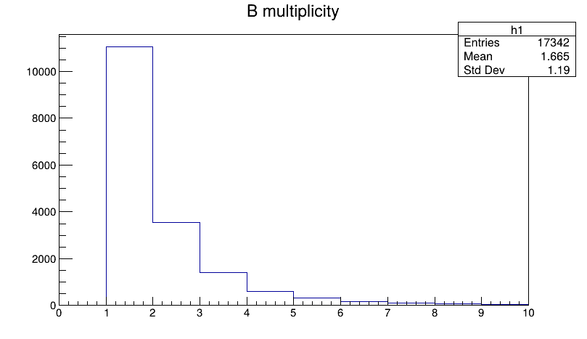
Multiplicity Correction : Random Selection
DATA RI
MC RI
DATA RII
MC RII

Slide 19
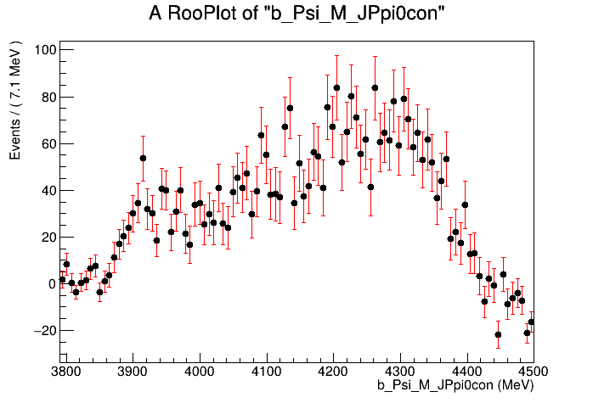
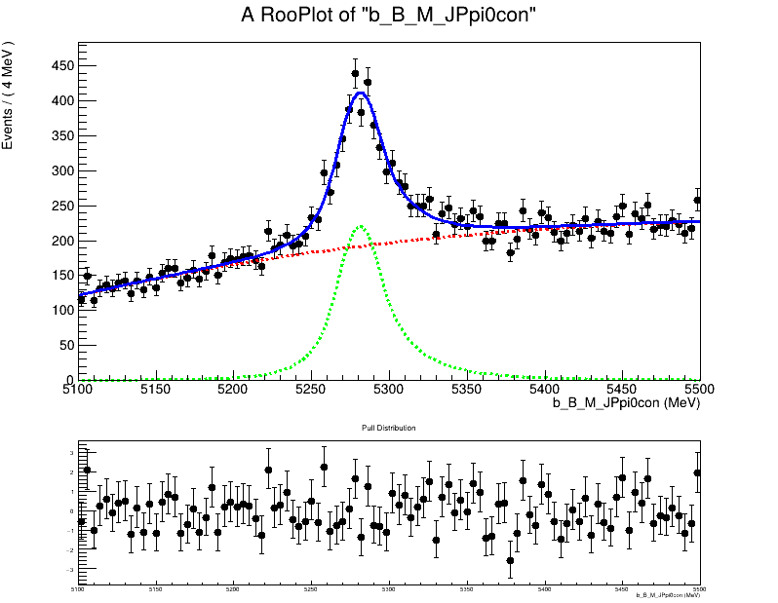
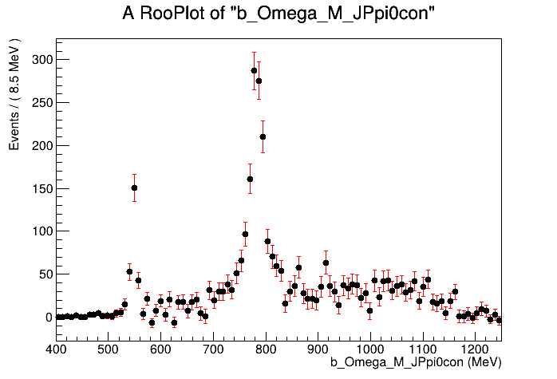
DATA : B⁰ → (J/ψπ⁺ π⁻ π⁰ )π⁺ K⁻
DATA RII
Yield = 2658 +/- 90.44

Slide 20
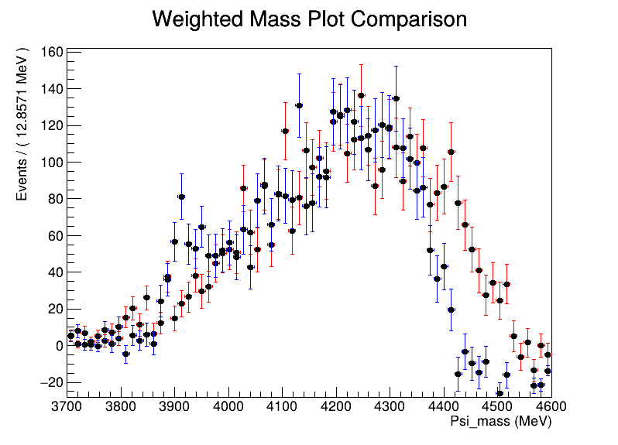
MC
DATA

Slide 21
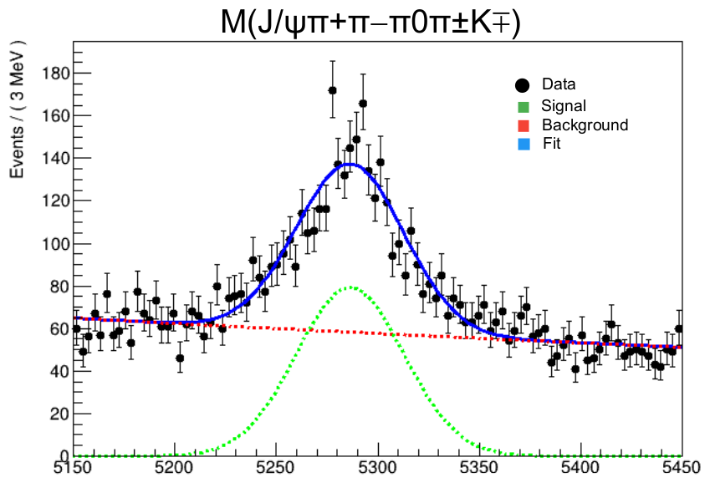
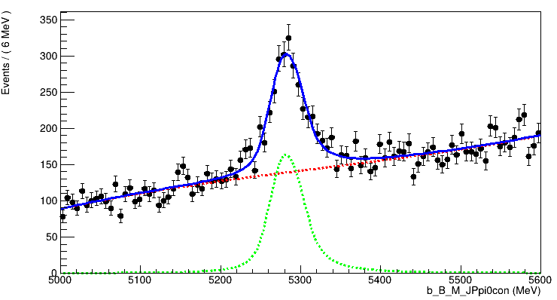
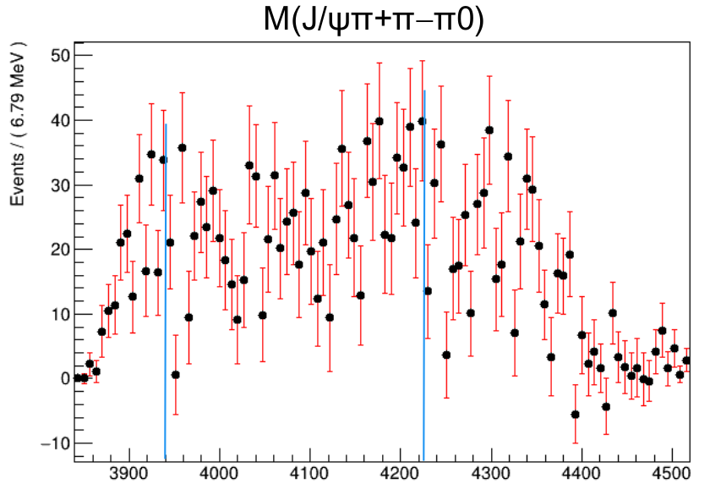
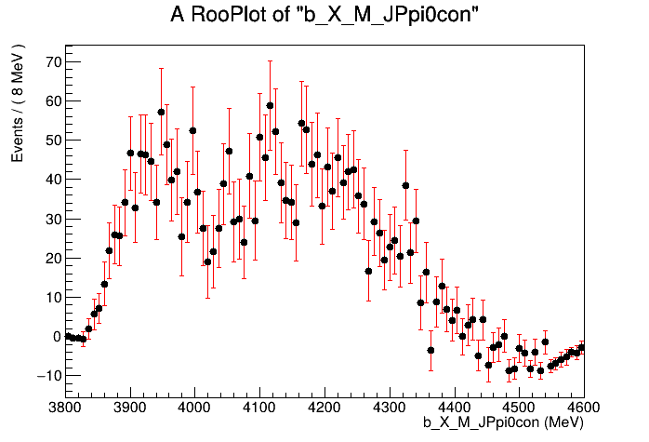
DATA : B⁰ →J/ψωπ⁺K⁻
BDT

Slide 22
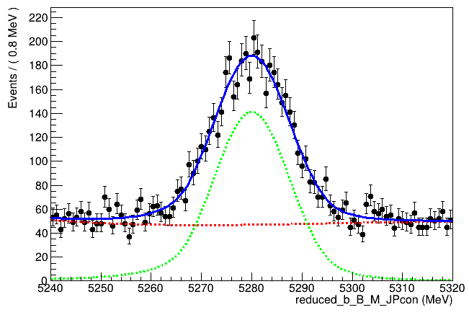
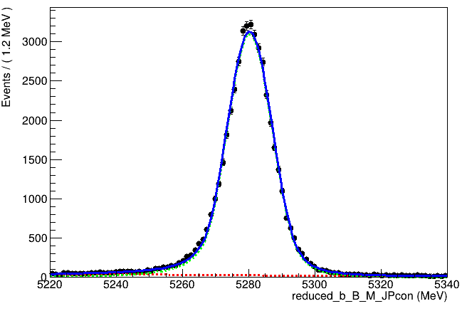
Reference Channel
Reference channel : B⁰ →J/ψ π⁺π⁻ π⁺π⁻
B.F. measurement by LHCb for run I only : Phys. Rev. Lett. 112, 091802 (2014)
Br ( B⁰ →J/ψ π⁺π⁻ π⁺π⁻) = 0.361 ± 0.017 ± 0.021
Br ( B⁰ →J/ψ π⁺π⁻ )
DATA RII
MC RII
Yield = 3452 +/- 85.74
Yield = 46538 +/- 235.9

Slide 23
Branching fraction measurement
Br ( B⁰→J/ψπ⁺π⁻ π⁰π⁺K⁻ ) = ❲N1*E2❳
Br (B⁰ →J/ψπ⁺π⁻π⁺π⁻) ❲E1*N2❳
N1 = Yield of Signal from data
E1 = Efficiency for signal (Ratio of yield from MC to total MC events)
N2 = Yield of Reference channel from data
E2 = Efficiency for reference channel
Errors from all variables are added in quadrature.
Separate calculation for run I and II and combination done by weights :
w_{RI} = (1/σ²_{RI}) / (1/σ²_{RII}+1/σ²_{RI}) and w_{RII} = (1/σ²_{RII}) / (1/σ²_{RII}+1/σ²_{RI})
B.F _{comb} = w_{RI} B.F_{RI} + w_{RII} B.F_{RII}

Slide 24
Branching fraction measurement
Br (B⁰→J/ψπ⁺π⁻ π⁰π⁺K⁻)
Br (B⁰→J/ψπ⁺π⁻π⁺π⁻)
B⁰ → (J/ψ π⁺ π⁻π⁰ )π⁺K⁻
Combined RI & RII : B.F = 27.0 +/- 1.3
Run I : 22 +/- 2.54
Run II : 27.62 +/- 1.437
Br(B⁰→ψ(2S)ρ⁺K⁻) = ❲N1 * E2❳
Br(B⁰→J/ψπ⁺π⁻π⁺π⁻) ❲E1 * N2❳Br(ψ(2S)→J/ψπ⁺π⁻)*Br(ρ⁺→π⁺π⁰ )
Run I : 42.27 +/- 4.68
Run II : 41.85 +/- 1.81
B⁰ →ψ(2S)ρ⁺K⁻
Combined RI & RII : B.F = 41.9 +/- 1.7

Slide 25
Conclusions
We have made observation of 3 new decay modes of B0 meson along with presence of signatures from exotic tetraquarks as intermediate states.
We measure their relative branching fraction.
Next steps in analysis
For each decay mode, estimate systematic uncertainty.
To claim observation of exotics an amplitude analysis would be needed : Not enough time to do that now!

Slide 26
BACK-UP

Slide 27
A brief history of Hadron spectrum

Slide 28
OZI rule : Hadronic decays that require quark-antiquark annihilation and reformation into different flavors are strongly suppressed.
Involve intermediate gluons which do not disconnect the quark lines : "connected diagrams".
Processes are leading-order in perturbation theory
Often involve gluon-rich final states.
Require the cc pair to annihilate and then hadronize into light quarks.
Involve loop-level diagrams or require multiple gluons and are thus higher-order and rarer.
The decay amplitude is much smaller because it involves "disconnected diagrams".

Slide 29
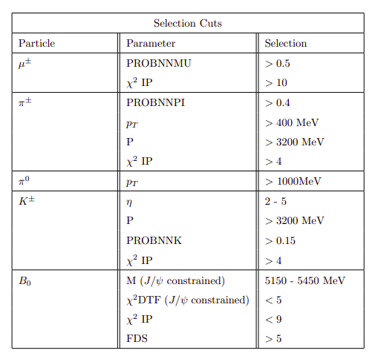

Slide 30
Boosted Decision Tree (BDT)
Decision trees employ sequential cuts to perform the classification task.
At each step in the sequence, the best cut is searched for and used to split data.
This process is continued recursively on the resulting partitions until a given terminal criterion is satisfied.
The training data set containing signal and background events.
Signal : Monte Carlo data for the signal
Background : Sideband events excluding signal region in raw data
Discriminating Variables
Difficult to make a very good discriminant, but simpler, more error-prone (high bias) i.e. Weak Classifiers.
Boosting : goal is to combine weak classifiers into a new, more stable one, with a smaller error rate and better performance

Slide 31
How to do it ?
Reconstruct MC data for each year on the same code as detector data (keep preselections same).
Extract pure signal by using variable BKGCAT = 0.
Extract sideband from reconstructed data (each year): 5150 < B mass > 5450
Signal region : 5200 < B mass < 5400
Divide both into 2 data sets : Training and Testing .
Randomisation is important !!!
Applying various machine learning algorithms, easy!
The tediously lengthy part : design and optimisation of the model itself, and how to pick the best one.
Variable selection : No tricks!
How to optimise classifier ? : No tricks!

Slide 32
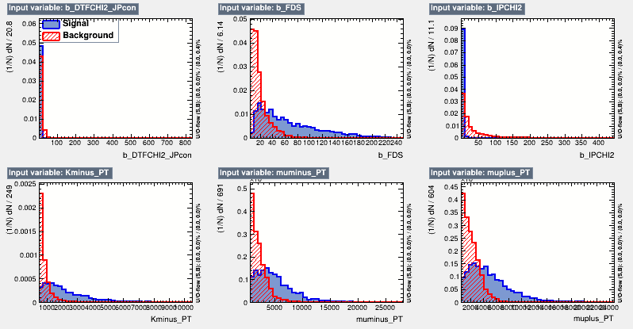
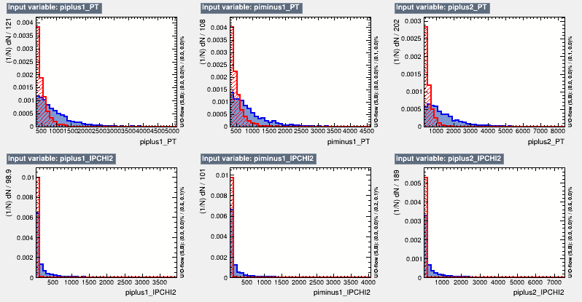
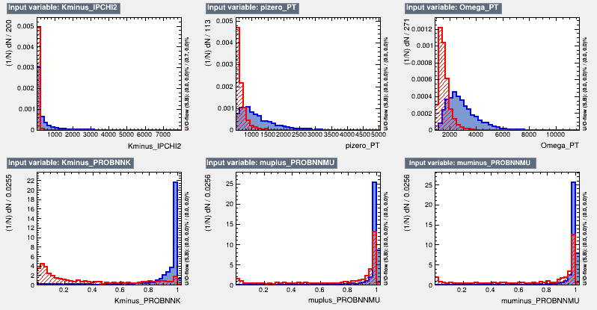
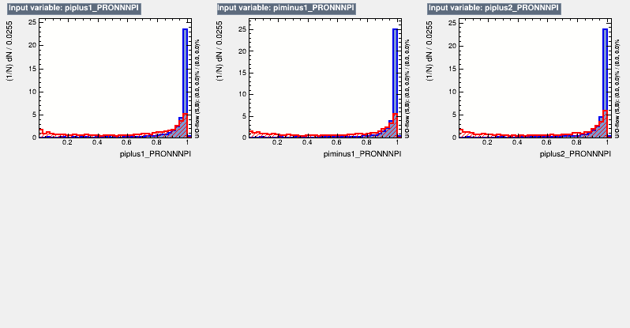

Slide 33
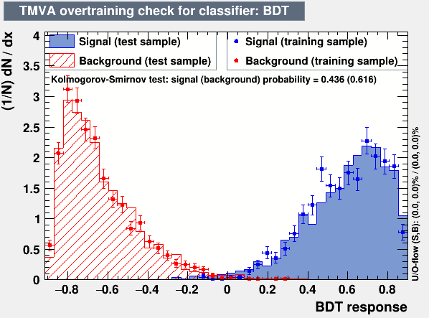
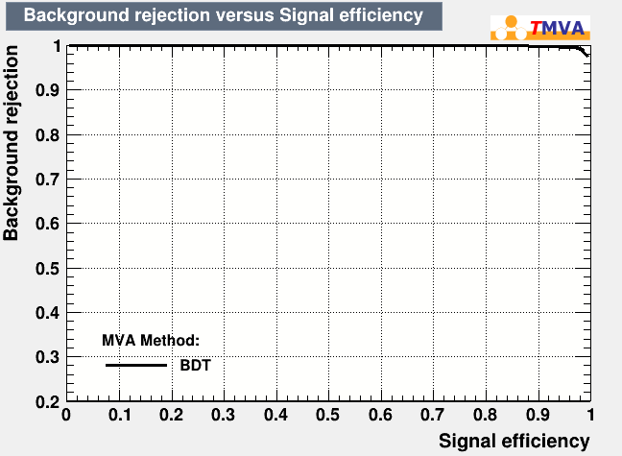
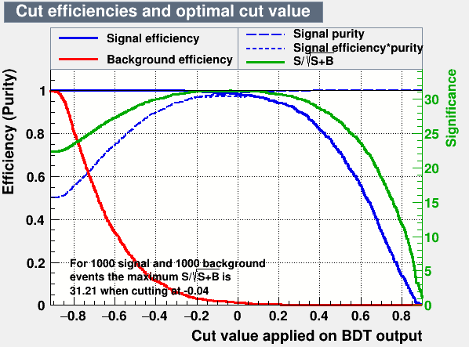
Apply training on whole data set, each run separately.
“Friend” this training output event by event with data.
New variable produced : BDT variable associated with every event.
Values vary between : 0 and 1

Slide 34
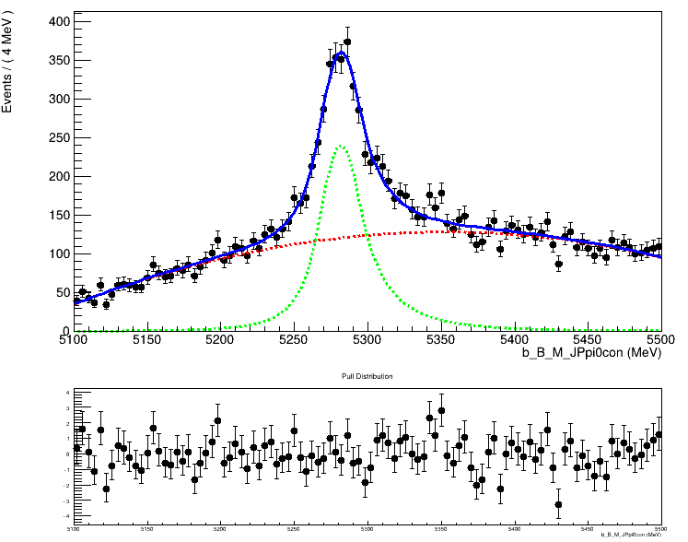
FINAL FIT MC
MC RII
Apply BDT training on MC
Cut at optimum working point
Apply all vetoes
Perform multiplicity correction
Use same model to make a fit and extract signal yield
Yield = 3263 +/- 87.46

Slide 35
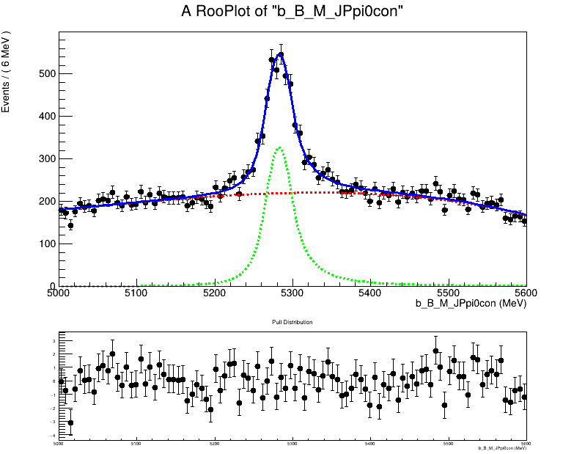
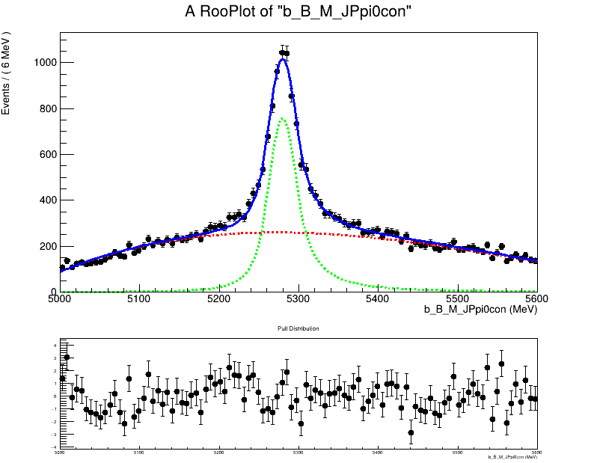
FINAL FITS : B⁰ →ψ(2S)ρ⁺K⁻
DATA RII
MC RII

Slide 36
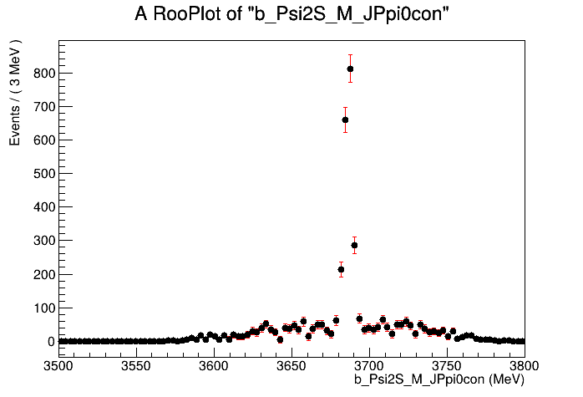
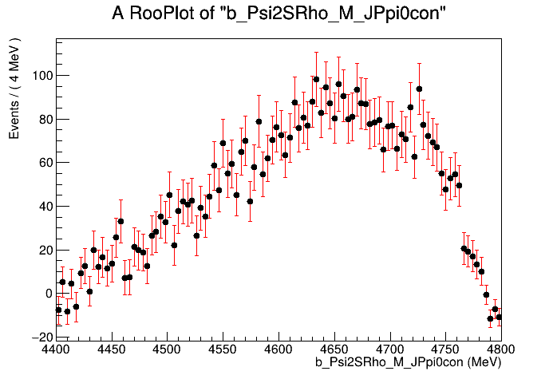
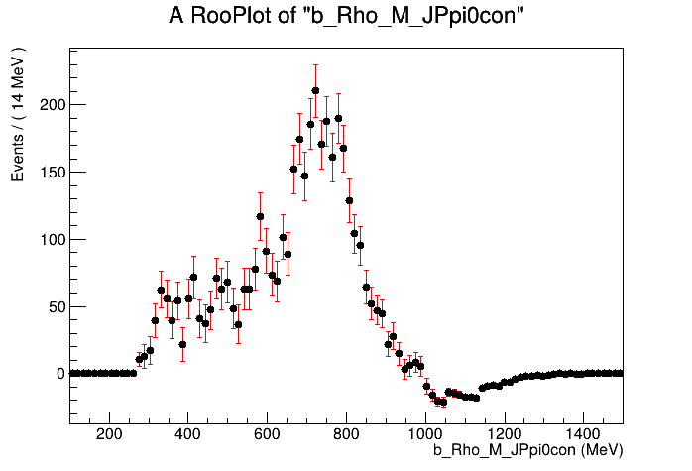
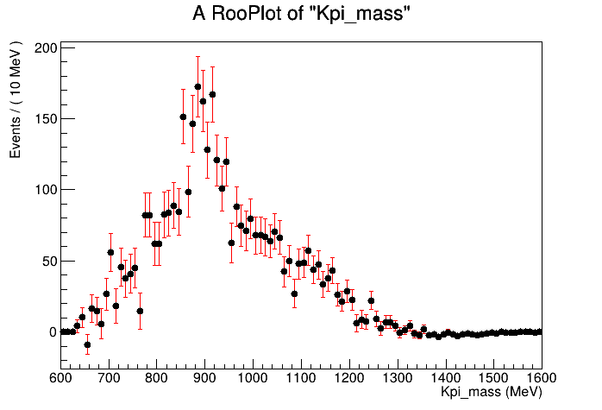
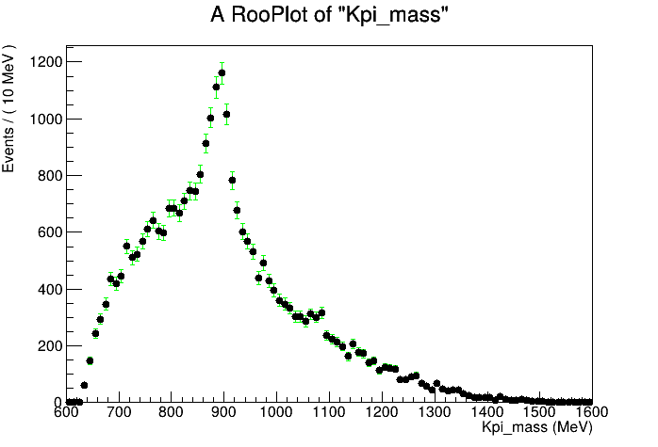
ψ(2S)ρ⁺
ψ(2S)→J/ψ π⁺π⁻
ρ⁺→π⁰π⁺
Signal : π⁺K⁻
Bkg : π⁺K⁻

