Slide 1
Nature of inertia and dynamic gravitational field
Branko Kovac

Slide 2
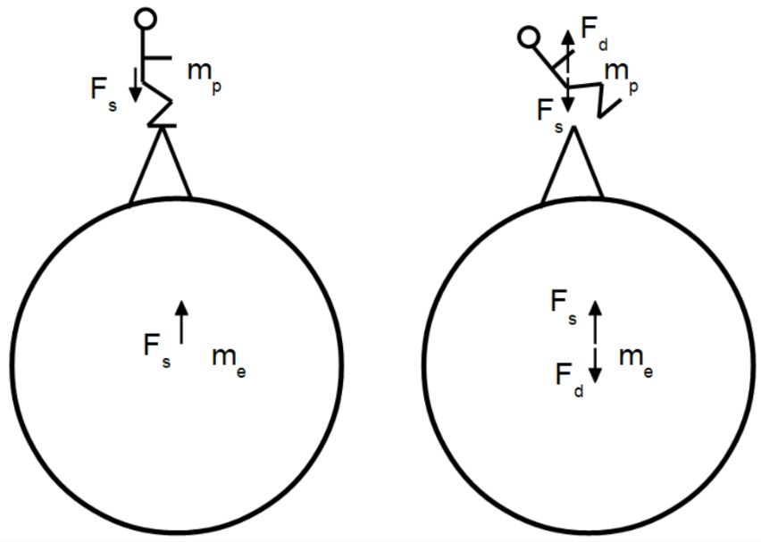
Mass dynamics and free fall
Every gravitational field has its source and every mass is the source
Force on the person is matched by force on the mass that is a source of gravitational field
When a person starts free fall, contact forces are removed, and weight is matched by inertial force
A dynamic force of the same magnitude should develop on the other mass
Every inertial force on the Earth or in the solar system has a reaction force that originates from the mass
Analysis done using the law of gravitation and law of motion without abstract objects

Slide 3
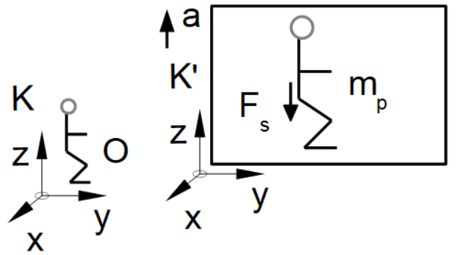
Mass dynamics explained by abstract objects
In the abstraction process, we extract characteristics or features of the real physical objects
Acceleration without the mass of Earth has no reaction force that is either inertial or gravitational
We created abstraction by neglecting the Earth which is the biggest mass in the system and provides
◦ Reference coordinate system
◦ Reaction force
◦ Anchor point for applying external force
◦ Gravitational field in which experiments are conducted
We never carried out experiments with mass dynamics without the big mass of the Earth present

Slide 4
Background on the nature of inertia
The inertial property of mass was introduced by Galileo and Newton. Newton distinguishes “vis inertia” from the impressed force. Newton introduced concept of absolute space
“As long as the principle of inertia is regarded as the keystone of physics, this standpoint is certainly the only one that is justified. But there are two serious criticisms of the ordinary conception. In the first place, it is contrary to the mode of thinking in science to conceive of a thing (the space-time continuum) which acts itself, but which cannot be acted upon. This is the reason why E. Mach was led to make the attempt to eliminate space as an active cause in the system of mechanics.” A. Einstein - The Meaning of Relativity
“Newton’s experiment with the rotating vessel of water simply informs us, that the relative rotation of the water with respect to the sides of vessel produce no noticeable centrifugal forces, but that such forces are produced by its relative rotation with respect to the mass of the earth and other celestial bodies.” E. Mach – The Science of Mechanics
E. Mach attempted to remove the space as an active participant in creating inertial force but has failed to provide equations. The criticism that Einstein considered serious was never tested by the experiment

Slide 5
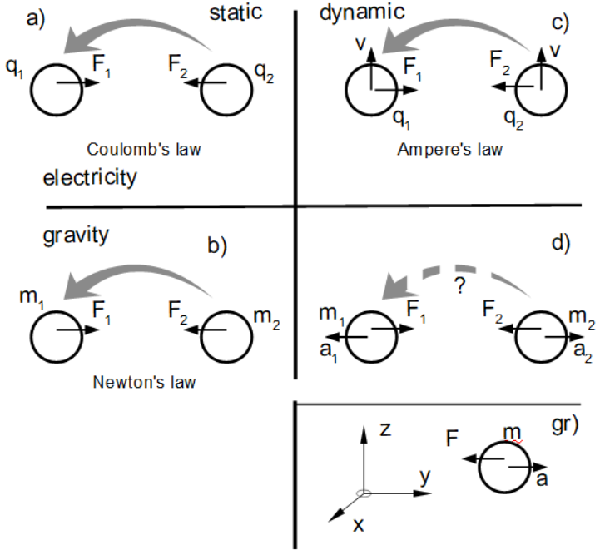
Concept of force field for electric charge and mass
On accelerating mass, we see inertial force, not inertia
Small but important epistemological difference
Common features of the force field:
Space around the object is ”excited”
Force on an object is created by the force field and not because of the property of the object
The principle of action and reaction is satisfied

Slide 6
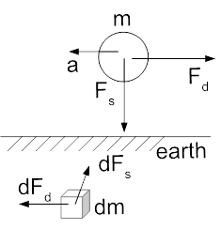
Estimating the strength of dynamic gravitational field
Magnitudes for the weight of the mass F_{s} and inertial force for mass accelerated at a=10m/s² F_{d} are close.
Then dF_{s} should be close to dF_{d}
dF_{d} is large enough to be tested in a laboratory
dF_{d} is small enough not to be detected without an instrument
The instrument needed to detect dF_{d} should be sensitive enough to detect dF_{s}
-${\vec{F}}_{s}=\int_{V}{{\vec{g}}_{s}ρdV}$
(1)
-${\vec{F}}_{d}=m\vec{a}=\int_{V}{{\vec{g}}_{d}ρdV}$
(2)

Slide 7
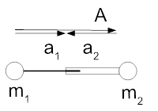
Forces and accelerations in system of two masses
The simplest case is the case of two masses
Definition of symbols
Balance of forces using the equation of motion
$−{\vec{a}}_{2}=\frac{m_{1}}{m_{2}}{\vec{a}}_{1}$
Acceleration from the reference coordinate system (M = m₁+m₂)
${\vec{a}}_{1}=\vec{A}\frac{m_{2}}{M}$
(3)
(4)

Slide 8
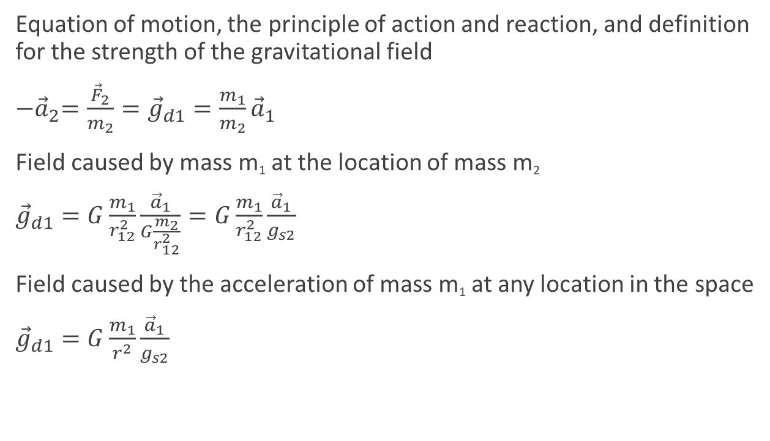
Equation for dynamic gravitation field for two point masses
Equation of motion, the principle of action and reaction, and definition for the strength of the gravitational field
${−\vec{a}}_{2}=\frac{{\vec{F}}_{2}}{m_{2}}={\vec{g}}_{d1}=\frac{m_{1}}{m_{2}}{\vec{a}}_{1}$
Field caused by mass m₁ at the location of mass m₂
${\vec{g}}_{d1}=G\frac{m_{1}}{r_{12}^{2}}\frac{{\vec{a}}_{1}}{G\frac{m_{2}}{r_{12}^{2}}}=G\frac{m_{1}}{r_{12}^{2}}\frac{{\vec{a}}_{1}}{g_{s2}}$
Field caused by the acceleration of mass m₁ at any location in the space
${\vec{g}}_{d1}=G\frac{m_{1}}{r^{2}}\frac{{\vec{a}}_{1}}{g_{s2}}$
(5)
(6)
(7)

Slide 9
Equation for dynamic gravitation field for distributed masses
Discrete distributed point masses
${\vec{g}}_{d1}=G\frac{m_{1}}{r^{2}}\frac{{\vec{a}}_{1}}{\sum_{i=2}^{n}{g_{si}}}$
Continuously distributed masses
${\vec{g}}_{d1}=G\frac{m_{1}}{r^{2}}\frac{{\vec{a}}_{1}}{\int_{V}{G\frac{ρ_{i}}{r_{1i}^{2}}dV}}$
The denominator is a scalar static gravitational field
Dynamic gravitational field on the earth’s surface
${\vec{g}}_{d1}=G\frac{m_{1}}{r^{2}}\frac{{\vec{a}}_{1}}{2πGρR}=G\frac{m_{1}}{r^{2}}\frac{{\vec{a}}_{1}}{14.72}$
(8)
(9)
(10)

Slide 10
Properties of inertial force calculated by dynamic gravitation
${\vec{g}}_{d1}=G\frac{m_{1}}{r^{2}}\frac{{\vec{a}}_{1}}{14.72}$
Always opposite to the acceleration
The principle of action and reaction is satisfied
Magnitude is independent of the direction of acceleration relative to the earth
Magnitude is independent of location on earth
Mass distribution defines the referent coordinate system (4)
The denominator in (9) determines the properties of space around accelerating mass
The inertial property of the mass plays a role similar to the inductance of the coil in electromagnetic theory

Slide 11
Motion of the planets in solar system by dynamic gravitational field
Balance of forces in system of masses – the sum of static and dynamic gravitational fields should be zero
$G\frac{m_{1}}{r_{12}^{2}}\frac{{\vec{a}}_{1}}{G\frac{m_{2}}{r_{12}^{2}}}+G\frac{m_{1}}{r_{12}^{2}}{\vec{r}}_{0}=0$
The similarity between Newton’s method and the dynamic gravitational field
Accelerations for planet and sun are the same for both methods
The orbital period is the same
The conceptual difference between Newton’s method and the dynamic gravitational field
The planet and the sun should both accelerate
Acceleration of planets would cause force on other planets
(11)

Slide 12
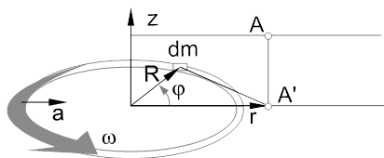
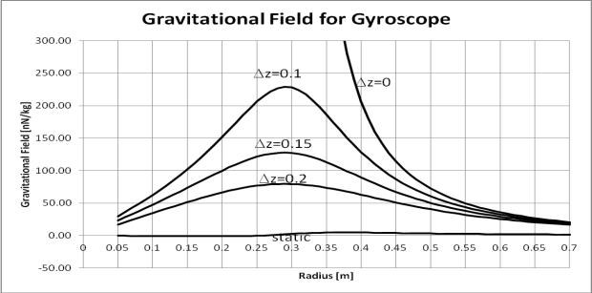
Dynamic gravitational field for gyroscope
The gyroscope provides mass that is accelerating continuously relative to us
Field calculated as
${\vec{g}}_{d}=\int_{−π}^{π}{G\frac{ω^{2}R}{14.72}\frac{cos⁡(φ)λRdφ}{\left(z^{2}+r^{2}+R^{2}−2rRcos(φ)\right)}}$ (12)
Gyroscope with m=10kg, r=0.3m, n=360rpm (equivalent of 40km/h)
Distance from xy plane in metres as parameter
Gravitational field strength in Cavendish experiment about 200nN/kg (158kg @ 0.23m)

Slide 13
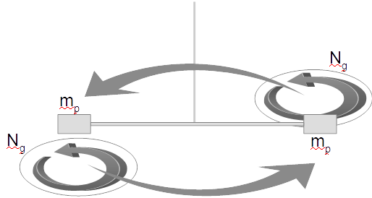
Experiment set-up
Torsion balance with two gyroscopes
Field strength proportional to the square of gyroscope working speed N_{g}
Vibration and air movement problems
Safety of people

Slide 14
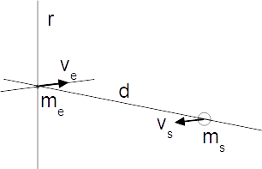
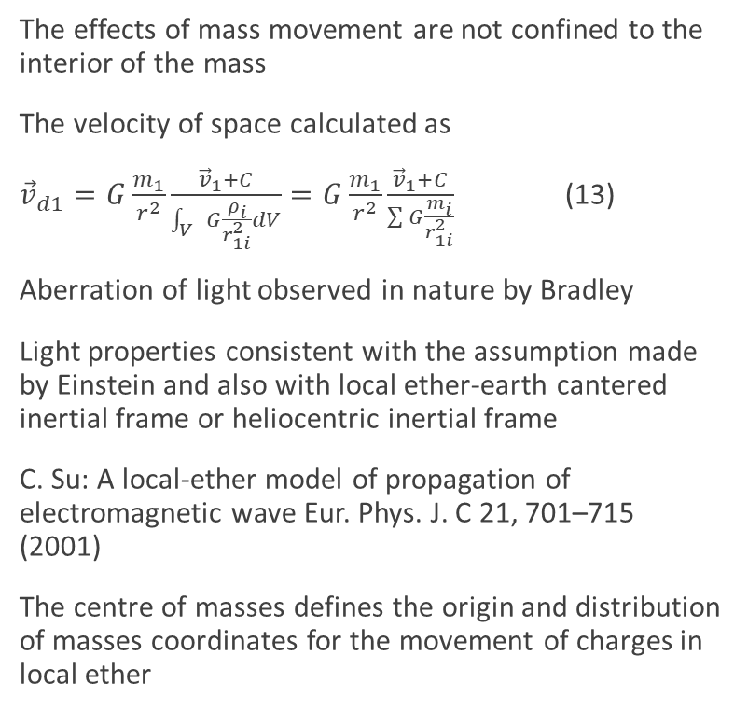
Aberration of light
The effects of mass movement are not confined to the interior of the mass
The velocity of space calculated as
${\vec{v}}_{d1}=G\frac{m_{1}}{r^{2}}\frac{{\vec{v}}_{1}+C}{\int_{V}{G\frac{ρ_{i}}{r_{1i}^{2}}dV}}=G\frac{m_{1}}{r^{2}}\frac{{\vec{v}}_{1}+C}{\sum{G\frac{m_{i}}{r_{1i}^{2}}}}$ (13)
Aberration of light observed in nature by Bradley
Light properties consistent with the assumption made by Einstein and also with local ether-earth cantered inertial frame or heliocentric inertial frame
C. Su: A local-ether model of propagation of electromagnetic wave Eur. Phys. J. C 21, 701–715 (2001)
The centre of masses defines the origin and distribution of masses coordinates for the movement of charges in local ether

Slide 15
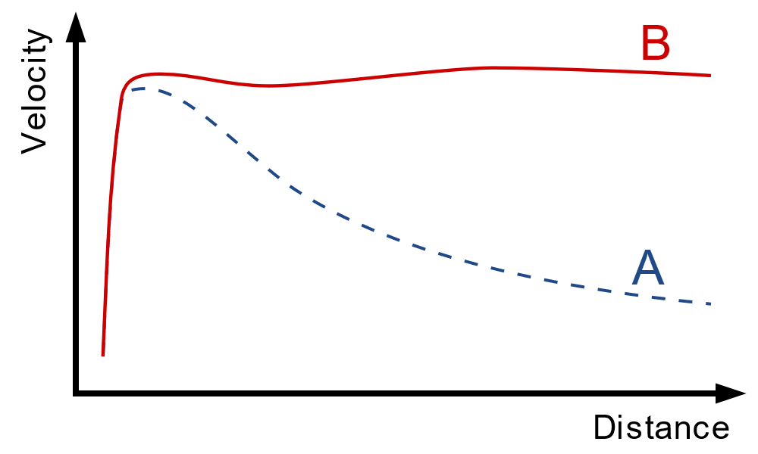
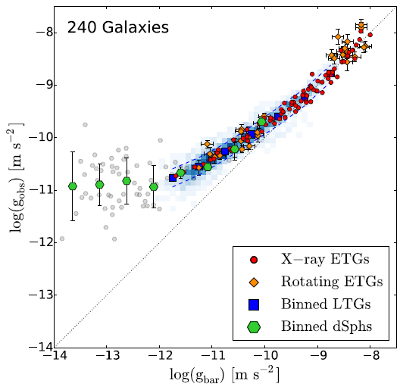
Dark matter or additional gravitational pull
Observed velocities of stars in galaxies are much higher than those predicted by Newton’s method scale about 150km/s and 150 000 light-years
Lelli et al. analyzed 240 galaxies and found a common relation that governs velocities
Observed radial accelerations would be concentrated around diagonal if gravitational and inertial mass were equivalent
The dark matter hypothesis was introduced to address discrepancies in velocities
Milgrom abandoned the equivalence principle and modified the second Newton axiom to achieve a good agreement with the velocities of stars
The galaxy is a giant gyroscope, and the dynamic gravitational field creates an additional gravitational pull towards the center of the galaxy
Phil Hibbs, Public domain, via Wikimedia Commons
https://commons.wikimedia.org/w/index.php?curid=365013
Lelli F. et all – One Law to Rule Them All: The Radial Acceleration Relation of Galaxies – The Astrophysical Journal, 836:152 (23pp), 2017

Slide 16
Conclusion
Dynamic gravitational field or inertial force without a reaction force
The dynamic gravitational field is quasi-stationary
The experiment will strengthen the case for the general theory of relativity or open a new avenue for gravitational research
Looking for new Cavendish or Eötvös
“The Nature of Inertia Explained Using the Field Theory” DOI: 10.4236/jhepgc.2024.102045

Slide 17
Thank you!!

