Slide 1
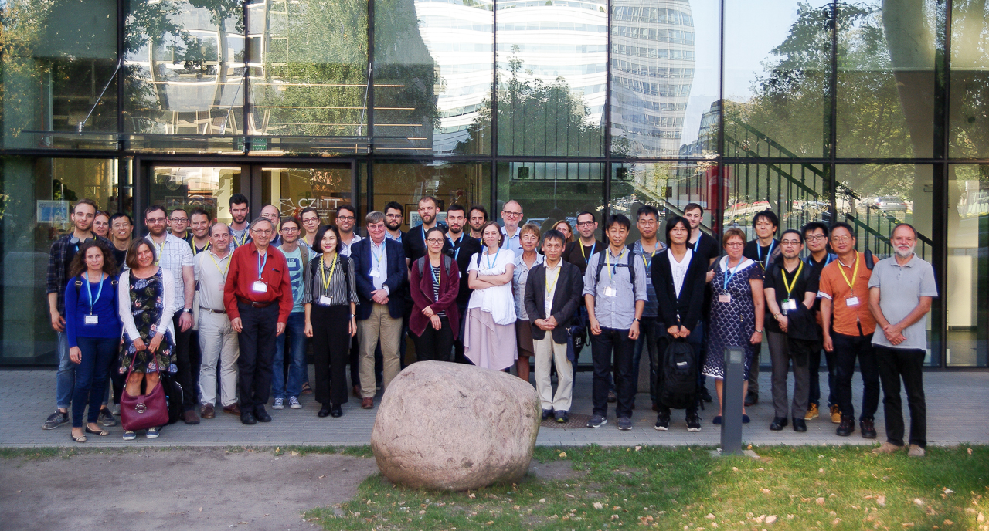
THANK YOU FOR YOUR CONTRIBUTIONS AND VISITING WARSAW!
photos: https://drive.google.com/drive/folders/1guLBt7fgUPXdO_0okT7oXFf-MUoSL5cU

Slide 2
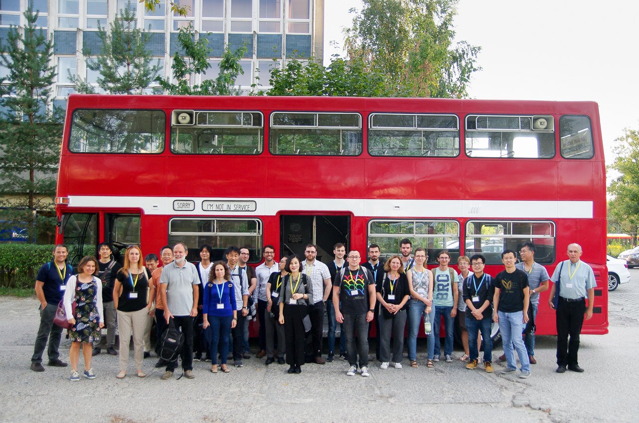
THANK YOU FOR YOUR CONTRIBUTIONS AND VISITING WARSAW!
photos: https://drive.google.com/drive/folders/1guLBt7fgUPXdO_0okT7oXFf-MUoSL5cU

